Slide 1
Teaching the Sacraments
Pastor Jon Zabell
2014 National Conference on Worship, Music, and the Arts

Slide 2
Baptism
“So you see plainly that there is no work done here by us, but a treasure, which God gives us and faith grasps” (LC IV, 37).
Notes:
Mother to her teenage son - “I don’t know what you were doing outside, but you’re covered in dirt, and you have to be at work in 20 minutes. Take a shower!”
Two purposes of washing - makes you clean - readies you for work
Baptism is our bath.

Slide 3
Communion
“Here (Christ) offers to us the entire treasure that he has brought for us from heaven” (LC V, 66).
Notes:
Communion is our meal.
“Without food, we would starve to death. We have to eat to fuel our physical life; otherwise, we grow weak and waste away. The only food that can sustain our bodies comes from the death of other living things. Whether we are nourishing ourselves from a bloody steak or ripped up plants in a vegetarian casserole, there can be no life, even on the physical level, apart from the sacrifice of other life. What is true for physical life is true for spiritual life – we can only live if there has been a sacrifice. And we can only live if we have continuing nourishment.” (Gene Edward Vieth, Jr. The Spirituality of the Cross: The Way of the First Evangelicals. (Saint Louis: Concordia Publishing House), 53.
Neglecting the sacraments is like saying, “I’m not really into eating or bathing.”
We want to know them, live them, teach them.

Slide 4
Aim
We want to be empowered, motivated, and equipped to teach the Sacraments in our homes, our churches, and our classrooms.
Notes:
What do we mean by “teach”? (click)

Slide 5
Aim
We want to be empowered, motivated, and equipped to teach the Sacraments in our homes, our churches, and our classrooms.
Notes:
What do we mean by “teach”?
Teaching what the sacraments mean.
Leading others to approach life sacramentally.
Who does this teaching?
vocation (everyone becomes a teacher at some point)
broad sense. anyone who is not in solitary confinement. In fact, even someone who is!
So: Aim not just for this session today, but for life.
Transition: If you ask a teacher whether this year’s class is going well or not, the answer back will usually be student-related. Biggest challenge to teaching the sacraments has nothing to do with your “students.” You know that the biggest challenge has to do with you.

Slide 6
Notes:
starting at 15:00
What is it about this message that resonates with absolutely everyone?

Slide 7
Obstacle
I know that nothing good lives in me, that is, in my sinful nature. For I have the desire to do what is good, but I cannot carry it out.
Romans 7:18
Notes:
What good things do we want to do with the Sacraments? (Click)

Slide 8
Obstacle
I know that nothing good lives in me, that is, in my sinful nature. For I have the desire to do what is good, but I cannot carry it out.
Romans 7:18
Notes:
What good things do we want to do with the Sacraments?
We want to learn more about them, appreciate them, use them, live in them, build our lives on them, model them for others, TEACH them.
But what? I cannot carry it out.
Why not? Because nothing good lives in me.

Slide 9
Obstacle
For out of the heart come evil thoughts, murder, adultery, sexual immorality, theft, false testimony, slander.
Matthew 15:19
Notes:
Out of where? (click)

Slide 10
Obstacle
For out of the heart come evil thoughts, murder, adultery, sexual immorality, theft, false testimony, slander.
Matthew 15:19
Notes:
World’s advice: Follow your heart. What’s wrong? Shouldn’t use the heart symbol on Valentine’s Day. Ugly old thing! Should use a cross!

Slide 11
Obstacle
All our righteous acts are like filthy rags.
Isaiah 64:6
Notes:
Explain the word “All.” Why all? (Click)

Slide 12
Obstacle
All our righteous acts are like filthy rags.
Isaiah 64:6
Notes:
Explain the word “All.” Why all?
Because sin is ALWAYS with us. When I want to do good, evil is right there with me. Romans 7:21
Because sin is all-pervasive. Not one part of you remains untouched by sin. “Nothing good lives in me, that is in my sinful nature.” (Romans 7:18)

Slide 13
Forgive me for the times I’ve sinned.
Notes:
What do you like about this plea for help? Good to ask for forgiveness.
Based on scriptures we just read, what’s missing here? Seems to suggest there were times we didn’t need forgiveness. An open door for pharisaism.

Slide 14
Forgive me, because everything I am and do is sin.
Notes:
True confession. We are in desperate need of forgiveness and help every single moment. What does this mean? (click)

Slide 15
Sinner by nature
We want glory for ourselves.
We must turn inward for help.
We will fail.
We will hurt ourselves.
We will hurt others.
Notes:
“Let one of us sit at your right and the other at your left in your glory” (Mark 10:37).
Large Catechism IV, 7: “We contend and fight for Baptism chiefly because the world is now so full of sects arguing that Baptism is an outward thing and that outward things are of no benefit.” Explain? my feelings, my thinking, my will. Eastern mysticism. Joel Osteen. Makes sense! If I want glory for myself, this is the only way to attempt it!
“Woe to you, teachers of the law and Pharisees, you hypocrites! You are like whitewashed tombs, which look beautiful on the outside but on the inside are full of dead men’s bones and everything unclean.” - Matthew 23:27
eternity: the wages of sin is death. Either we fall into despair, or we fill ouselves with arrogant, sinful pride. CWS 738, “now prodigal, now Pharisee, O God, be merciful to me.” FEAR. We separate ourselves from God.
We burden them with the illusion of our Pharisaical attitude. In despair, we shift blame from ouselves to them.
So the challenge in teaching the sacramental life is not in finding the perfect study guide.
Challenge is that we are sinners, and so is everyone else.
We don’t have it “in us” to make our lives more truly Christian, more sacramentally focused.
We don’t have it in us. God has it for us.

Slide 16
Rescue
Blessed are those who hunger and thirst for righteousness, for they will be filled.
Matthew 5:6
Notes:
Note - help doesn’t come from IN US, but is provided FOR US
Who is doing the filling in this verse? (Passive verb. God is understood subject).
How does this filling happen? (Click)

Slide 17
Rescue
“Come to me, all you who are weary and burdened, and I will give you rest.”
Matthew 11:28
Notes:
Rest = rest from a guilty conscience. Forgiveness from sin.
Where do we find Jesus? (Click)

Slide 18
Rescue
“Baptism… saves you by the resurrection of Jesus Christ.”
1 Peter 3:21
Notes:
Where do we find Jesus?
Not from looking inside of ourselves (thoughts, feelings, not even by looking at our faith).
But in our Baptism.

Slide 19
Rescue
“Drink from it, all of you. This is my blood of the covenant, which is poured out for many for the forgiveness of sins.”
Matthew 26:27,28
Notes:
According to this verse, where do we find Jesus and his forgiveness?

Slide 20
Explain: In providing us the external sacraments of Baptism and Communion, God washes away our doubts and makes us certain of his love.
Notes:
When confidence rests in self, there can be only two possible conclusions: “I’m amazing!” or “I stink!” This is the path away from God. Our confidence needs to come from something outside of ourselves. Water, word, bread, wine = all come to us from outside ourselves. All are connected to Christ. They are given to us by God, and that makes them certain things, because God doesn’t lie.
“A wafer touches your tongue. A word strikes your ear: “the body of Christ, given for you.” This changes everything. Now you can work and pray and trust and forgive and rejoice. Are you feeling it? That doesn’t matter. God is saying it. God can’t lie.”

Slide 21
What part does a clean conscience play in our life of sanctification?
Notes:
Guilty conscience inevitably works the wrong motivation. Since sanctification is being set apart in heart, mind, will, and deed, there can be no sanctification without a clean conscience. We can make it look like we’re sanctified on our own, but only a clean conscience from God makes it truly so.
So then, knowing what the sacraments mean, we can tell others what the sacraments mean, our children, our family members, our students, our parishioners, our friends, our neighbors, our co-workers.
But there’s more to teaching than that. We want to do more than impart facts.
We want to lead others to approach life sacramentally. This is something more than just talking about what the sacraments mean.

Slide 22
Notes:
“Should the cabin experience a change in pressure, oxygen masks will drop from above you. Those of you traveling with children should first place a mask over your own face and then help your children.”
Why put a mask over your own face before helping your children? What truth can you draw for your life of sanctification?
Can’t be any good to others if you don’t take care of yourself. “I don’t have time to tend to my spiritual needs because I’m too busy serving” – May seem like a noble approach, but the idea that we can serve well without God’s grace is a hellish lie.
So you care of yourself. What does that look like? A person sitting in a church pew? Or walking up to communion? Or staring at a baptismal font? Sure, but behind the scenes, it looks like this: (click)

Slide 23
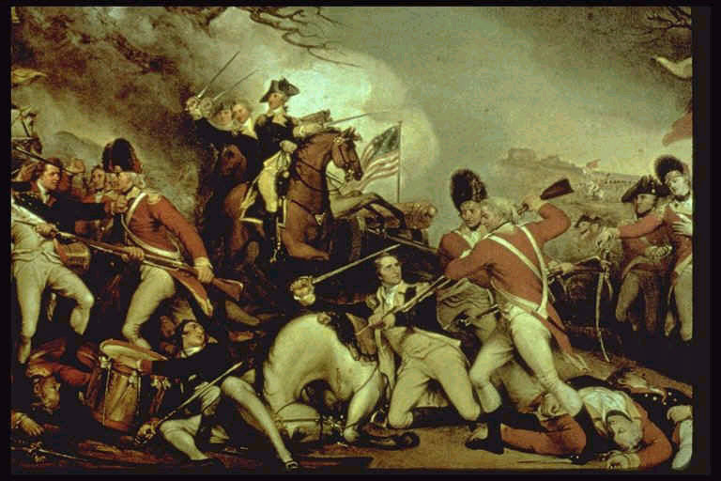
Notes:
Daily battle
New Self vs. old Adam
Romans 7:22-23
²² For in my inner being I delight in God’s law; ²³ but I see another law at work in the members of my body, waging war against the law of my mind and making me a prisoner of the law of sin at work within my members.
How do we fight this battle? (Click)

Slide 24
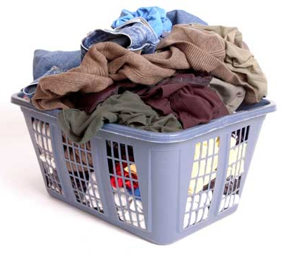
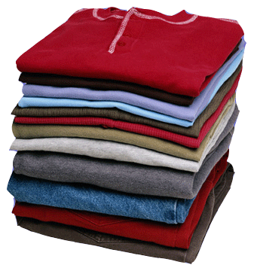
“You were taught...to put off your old self… and to put on the new self.”
Ephesians 4:22-24
Notes:
Confessing sin and trusting God for forgiveness are compared to changing out of old, dirty clothes and putting on new, clean ones.

Slide 25
a. It’s up to you to turn your life around each day.
b. Getting rid of sin is as easy as getting dressed.
c. People who own clothes that are clean and new will want to wear them.
Notes:
The point of this comparison is:
Not A. Why not? Vine / branches
Not B. Why not? (see picture above) Romans 7. Battle! Carry Cross! Deny self! No battle more fierce, more difficult than this one!
C. is the correct answer. In your baptism, God has given you everything you need for your marriage, your vocation, your life under the cross.
Practically speaking, how does this look?

Slide 26
Sacramental Living
It’s not about:
the rituals we use
decorations and ceremonies
doubling our communion attendance
Notes:
Remember what Jesus said about white-washed tombs?
Deal with the tomb.

Slide 27
Sacramental Living
It IS about:
daily contrition and repentance
daily putting on the new self.
Notes:
So it’s not ABOUT ritual and ceremony, or upping our communion attendance. (Click)

Slide 28
Sacramental Living
It IS about:
daily contrition and repentance
daily putting on the new self.
So we’d be fools to ignore ritual, ceremony and frequent communing.
Notes:
But since sacramental living is a DAILY thing ...
Ritual and ceremony can help sinfully forgetful people fight a daily battle. Can you think of examples? (Click)

Slide 29
Sacramental Living
So we’d be fools to ignore ritual, ceremony and frequent communing.
Notes:
(Daniel after edict is issued - Daniel 6:6-10). Luther’s morning, evening prayers, sign of the cross, kneeling for confession, praying before and after Communion, frequent communion in schedule (whenever it’s offered)
Transition: Forgiven, we find we can do new things, gladly, from the heart, like…. teach!
(Everyone becomes a teacher at some point, either wittingly or unwittingly.)

Slide 30
Teaching the Sacraments
Notes:
Good teaching is usually about
discovering your potential
learning independence
bettering yourself
Parents - let kids try washing dishes, let them make mistake, break dish, so they learn how to do it better - independence.
Pastors - equipping members to be leaders in the church - pastor not the one doing all the work.
Teachers - not just feeding kids answers. teaching them to love learning, so that they do it their whole life long, even without a teacher.

Slide 31
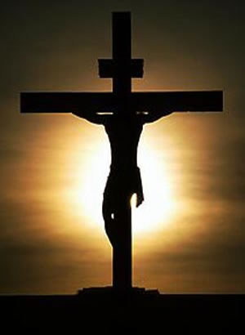
Teaching the Sacraments
Notes:
Teaching sacraments is a completely different kind of teaching.
Letting others in on what you have learned.
That left to yourself you are powerless, and that you are utterly dependent upon the gospel for anything and everything you need.
Teaching sacraments is about helping others discover that only God can make them better, and only through his means of grace.

Slide 32
Teaching the Sacraments
Agree/Disagree:
We should be careful about letting people be too confident of their salvation.
Notes:
True, if you’re talking about false confidence. But when it comes to confidence in Christ, you can’t have too much of a good thing. Does God seem “wary” in the passages above (“Come to me, I will give you rest. Baptism saves you. This blood is the new covenant in my blood.”)? There are no “if’s,” no strings attached, no demands for piety. We can trust the gospel to do what God says it will do (i.e., strengthen our faith in God and our devotion to him).

Slide 33
Teaching the Sacraments
Your friend says, “I went to Communion today, but I still don’t feel forgiven.” How might you respond?
Notes:
Feelings are important, but even though you don’t feel forgiven, you are. Jesus paid for all. He gave you his own body and blood for your forgiveness. ILLUS. Standing on an ice covered pond. Ice is 6 feet thick. Your friend: “I don’t feel like I’m standing on thick ice.” What would you say? Feelings have nothing to do with it. You’re standing firm!

Slide 34
Teaching the Sacraments
“[You have] been buried with him in baptism and raised with him…³ For you died, and your life is now hidden with Christ in God.” Colossians 2:12; 3:3
Notes:
In what sense is our Christian life hidden with Christ in God? (Click)

Slide 35
Teaching the Sacraments
“[You have] been buried with him in baptism and raised with him…³ For you died, and your life is now hidden with Christ in God.” Colossians 2:12; 3:3
Notes:
In what sense is our Christian life hidden with Christ in God?
Holy but can’t see it. Forgiven but can’t see it. Going to heaven but can’t see it. But it’s all there in your Baptism.
How does this truth help us and others deal with trouble in life?
When you have pain, it feels like you’re being punished. Baptism says otherwise. When it looks like all is lost, Baptism says otherwise. Etc.
How does this truth teach us and others to look at our life of sanctification?
Looks like I’m constantly failing. Baptism says otherwise. Looks like my work is useless, unimportant, in vain. Baptism says otherwise.

Slide 36
Teaching the Sacraments
“Love the Lord your God with all your heart, and with all your soul, and with all your mind… Love your neighbor as yourself.”
Matthew 22:37,39
Notes:
How much love does Jesus want us to have? Where does he want us to aim our love? (Click)

Slide 37
Teaching the Sacraments
“Love the Lord your God with all your heart, and with all your soul, and with all your mind… Love your neighbor as yourself.”
Matthew 22:37,39
Notes:
How much love does Jesus want us to have? Where does he want us to aim our love?
The love of heart, soul, and mind, all aimed at God and our neighbor.
Explain: The problem isn’t with our ability to love, but with our ability to aim our love in the right direction.
Heart, soul, and mind are indeed filled with love…. for self.
In the Sacrament of Holy Communion, at whom does Jesus aim his forgiving love?
Me.
What practical help does Communion give for loving others?
Frees me from the need to spend all my love on me. Already loved by Jesus with a love far above anything I could do for myself.

Slide 38
Resources
Bible
Small and Large Catechism
Hymnal, Supplement
Notes:
Bible:
Obviously the gospel accounts of the Last Supper, and the Apostle Paul’s commentary (1 Cor. 10-11).
Also Matthew 28:16-20, Mark 16, Acts 2, Galatians 3, Ephesians 5, Titus 3, 1 Peter 3
But really anywhere in scripture where law is preached and gospel is proclaimed - even OT - Anything that turns our gaze outward for rescue.
Small - Use devotionally. Confess - read - pray. Large - can’t say enough good about how LC draws you into sacramental thinking.
Hymnal/Supplement - Sing or say. Read to yourself. Read to your family. Bedtime prayer. Sacramental hymns.

Slide 39
Ideas for home
Daily Baptismal reminder
Communion preparation
Baptismal anniversaries
Discipline / Teach
Confession and Absolution
Notes:
teach the sign of the cross. like folding hands for prayer. Can you think of a better personal ritual for baptism? Pour water on your head?
read communion preparation page from hymnal at table on day before communion. Make kids eager to receive it when they’re ready.
mark them. celebrate them. ideas?
you are being good/ bad VS. Jesus was good for you / you’re baptized in his name. Luther’s small catechism. Just read it. Out loud. After supper.
tell them how. Show them how (when you sin against children, confess).

Slide 40
Ideas for church
Daily Baptismal reminder
Communion preparation
Baptismal anniversaries
Discipline / Teach
Confession and Absolution
Notes:
paschal candle / font focus
talk about it every so often (every fifth Sunday?) - do we want more communion services? Don’t push.
find baptism dates for all members / publish anniversaries each week / have elders or pastor send email on baptismal anniversary
Use a person’s baptism to encourage them to drown the sinful nature. To live a new life. Bible class ideas:
Use Confirmation Class lessons on Baptism / Communion for adult Bible study.
Do a Large Catechism Bible study on IV and V.
Do a Means of Grace Bible study (from Bible Basics) - with adults in church - use church symbols, including font, altar, pulpit.
Find a sacraments Bible study (JZ has one - 8 lessons)
Multiple choice Q&A for whole catechism. (JZ has this)
Use Baptism Gathering Rite on a non-baptism Sunday, with explanation in bulletin
Do a Bible class on Communion liturgy
Source material:
CW Manual, pp. 176-179. Divine Service 2 footnotes.
Plan: Study scriptural references in each element of liturgy, step by step.
Take each element of liturgy and ask what?, why?, and why now?
Use liturgy as lead in to study of sacraments.
Apply benefits of sacraments to everyday life.
Apply truths proclaimed in liturgy to everyday life.
Set office hours for this.

Slide 41
Ideas for classroom
Daily Baptismal reminder
Communion preparation
Baptismal anniversaries
Discipline / Teach
Confession and Absolution
Notes:
Classroom poster.
Talk about why you love Lord’s Supper. Pray for communicants. Build anticipation.
Celebrate them - bring a class treat. Light a candle. Sing a hymn.
Classroom management - law / gospel.
Send kids not just to principal’s office, but to pastor’s study. Tell pastor this kids needs the keys. He’ll know what you’re talking about.

