Slide 1
Insights from Sweden
Gunilla Hedkvist
LBK - Sweden
WELS Worship Conference, Kenosha, July 22-25, 2014
Notes:
I live in Norrköping, a city 2 hours south of Stockholm. It’s a fairly large city with about 130 000 inhabitants.
Our congregation, LBK Norrköping, rents the second floor in this building for their divine services. It is a well known house and only 5 minutes walk from the train station and the main shopping center.

Slide 2
Our worship space
Notes:
Every Sunday we have to rearrange the room. A large altar tapestry covers the whiteboard above the altar and Christian paintings decorate on the walls.
This Easter Sunday one of our confirmands had prepared an open grave decoration for the altar.

Slide 3
The view
Notes:
From the windows of our church you can see the City hall (the high tower) with Norrköping’s patron saint St. Olav sitting on a chair at the top. The other tower is Hedvig’s church, also called the German church.

Slide 4
The city of Norrköping
Notes:
An artificial brook runs through the park, Strömparken, in central Norrköping.

Slide 5
Little Niagara…
Notes:
Next to the park is the river ”Motal ström” with its many water falls.
Norrköping used to be the center of all textile industries in Sweden, a “Little Manchester”. There is no textile industry any more. It all moved to China and Thailand. Instead there are many high tech industries and a branch of the University of Linköping in the old factory buildings. You could call Norrköping “Little Niagara” if you think about all the water falls along the river.

Slide 6
Or Little Venice…
Notes:
Or ”Little Venice” when you see all the former factory buildings along the river and on islands in the river.

Slide 7
LBK
7 congregations
900 miles
6 pastors
200 members
Notes:
My church – The LBK
This is a map of Sweden. All the red dots are places where the LBK has a congregation or a preaching station. There are 7 congregations. The distance between the congregations most far away from each other is about 900 miles. We have 6 pastors and about 200 members.
LBK was founded in 1974, so this summer at our annual summer conference and summer camp we celebrated the 40th anniversary of our church. We had visiting pastors and professors and families from Bulgaria, Portugal, Germany, Finland, Norway, and the USA at the conference.

Slide 8
LBK 1974-2014
Notes:
Pictures from our 40 years anniversary celebration this summer.

Slide 9
Insights from Sweden
Early Swedish Church history
Swedish hymnal history - starts with the reformation
The Swedish hymnals produced in 1695, 1819, 1937, 1986
My three blue hymnals
My three red hymnals – LBK hymnal history
Where are we going from here?
Notes:
This is the outline of my presentation. We will look at Swedish church history and hymnal history, and look at where LBK is in this history as it is linked to hymnals and liturgies.
I will also talk a little about my own relationship to hymnals and liturgies.

Slide 10
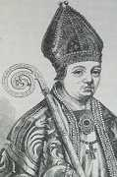
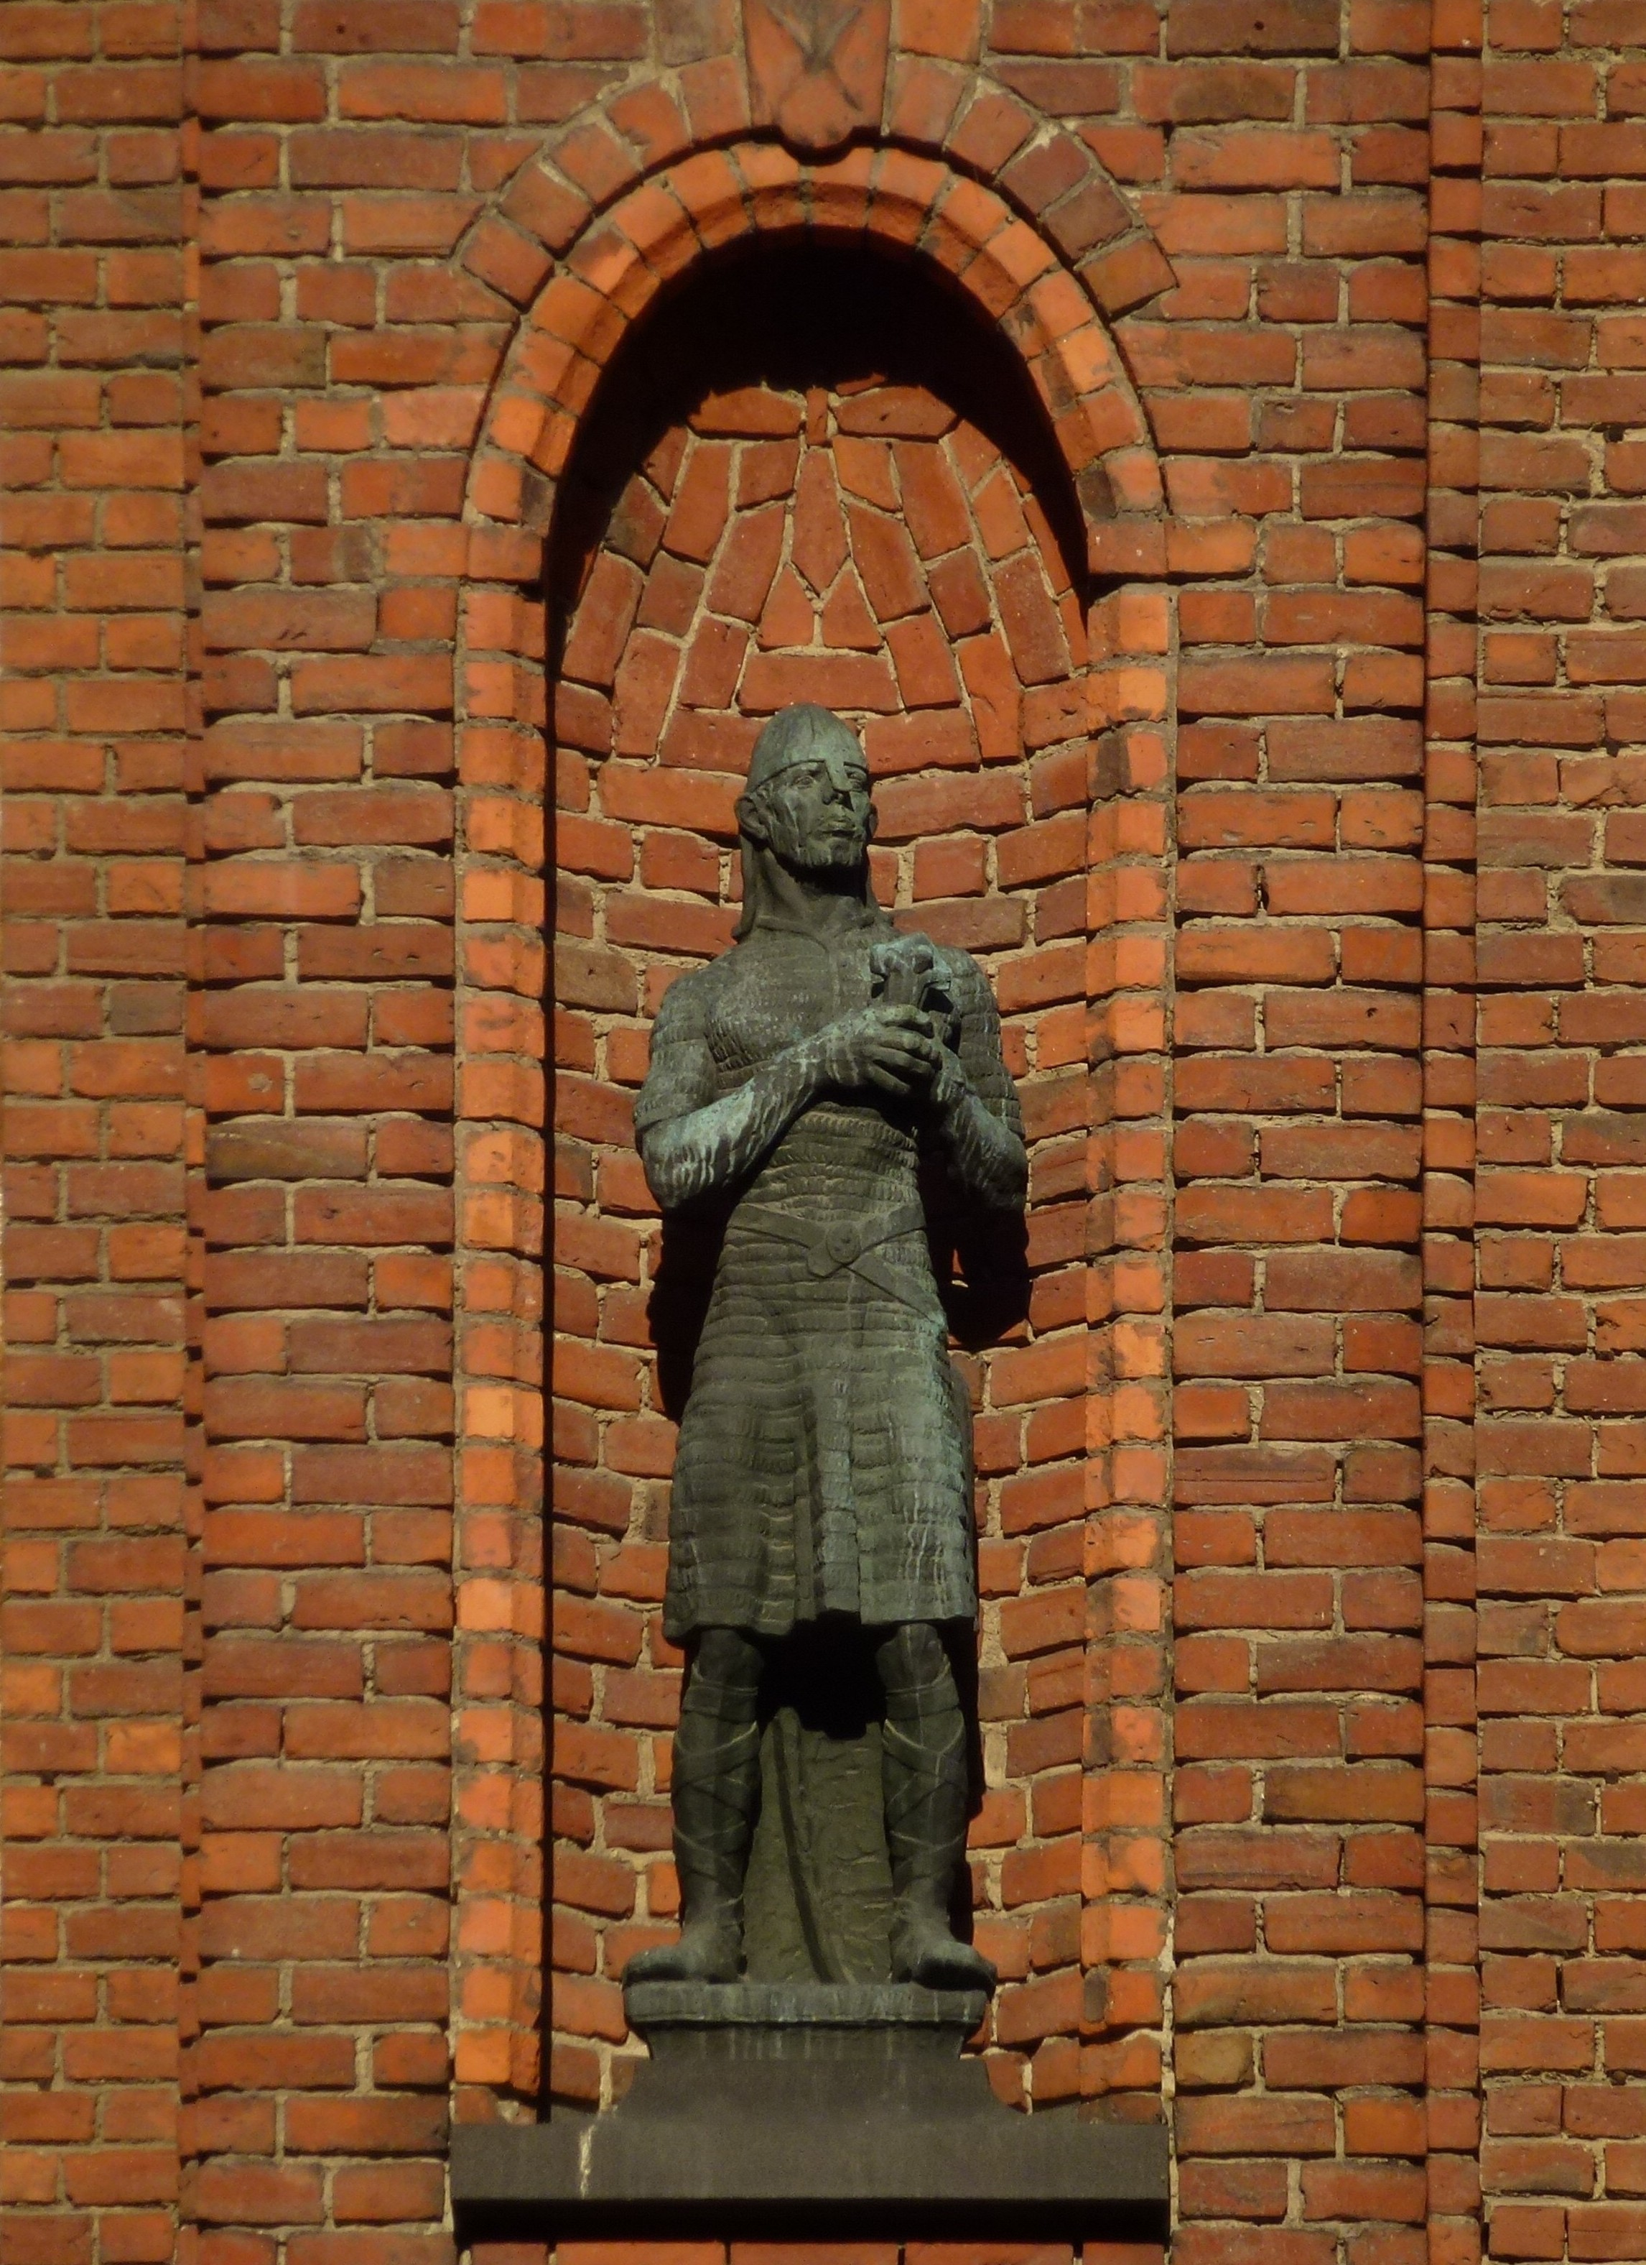
Early Swedish church history
Ansgar – the first missionary to Sweden, 820 and 850.
Birka – a Viking village just west of Stockholm
Olof Skötkonung ruled 995 – 1022
First king to be baptized and stay Christian until death
Notes:
Early Swedish church history
The first missionary to Sweden was Ansgar, in the middle of the 9th century. But it seemed that the church he founded in Birka, west of Stockholm, died out and a hundred years later there was no trace of it. Of course the country of Sweden didn’t exist at that time.
In the beginning of the 11th century there was a king named Olof Skötkonung. He was the first king to be baptized and who remained in the faith until his death even though he was forced to resign because of it. It was the English missionary Sigfrid who baptized him. Sigfrid became bishop over a western province in Sweden.

Slide 11
Church buildings 1100…
Notes:
If you travel in Sweden you will notice all the white church buildings on hills in the countryside. By the 12th century Christianity had spread and there are many churches still in use, which were built at this time. Östra Eneby church in Norrköping is one of them. Services are held here every Sunday and it is a popular church for weddings and baptisms. The oldest part of the church is from 1100 and the newest part, the tower, from 1775. The paintings in the ceiling are preserved from the 12th century.
Also very typical for Sweden is the graveyard surrounding the church. Even though there is no State church any more, the Swedish church still is the responsible organization for the burial sites and funeral chapels in Sweden. The so called “free churches”, evangelicals and the catholic church” never have graveyards.

Slide 12
… to 1775
Notes:
The pulpit is from the 18th century and rather typical, with reliefs of the the evangelists.
The organ is from the 19th century.
The ship in the ceiling is a votive gift, given to the church by sailors to show thankfulness to God after being saved from drowning. These ships are rather common in churches along the coast of Sweden.
At the time when this church in Östra Eneby was built there were no hymnals…

Slide 13
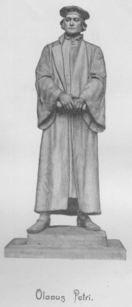
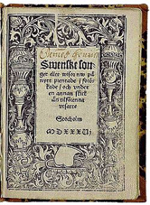
Swedish hymnal history starts with the Reformation
Olavus Petri and Laurentius Andreae
Studied in Wittenberg
1526 – first hymnal
8 reformation hymns
Enlarged editions
Notes:
Swedish hymnal history …
… starts with the Reformation
The Lutheran Reformation in Sweden was nearly simultaneous with the reformation in Germany. Two Swedes studied under Luther, Olavus Petri and Laurentius Andreae. When they came back to Sweden, the reformation was soon under way protected by the Swedish king Gustavus Vasa.
The first hymnal was produced in 1526, but the oldest preserved one is from 1530. The New Testament in Swedish was published in 1527. Olaus Petri both translated several of Luther’s hymns and wrote hymns, which are still in use today.

Slide 14
The Bible in Swedish
The complete Bible was published in 1541
”Gustav Vasa’s Bible”
Unifying factor for the Swedish language – spelling
Very dependent on Luther’s translation.
Notes:
At this time Sweden also got the first complete translation of the Bible. It was published in 1541 and named ”Gustav Vasa’s Bible”.
It was a unifying factor for the Swedish language and served as a rule for how to spell the Swedish language.
This translation was also very dependent on Luther’s translation.

Slide 15
The Uppsala hymnal
1645 – first attempt to make a hymnal for all of Sweden.
Printer lawlessness
Made their own additions and changes
The confusion was still great.
Notes:
Hymn singing became popular and many small hymnals were published without becoming used nation wide. The first hymnal used in most of Sweden was the “Uppsala hymnal” from 1645. The Uppsala hymnal was widely accepted in Sweden but printers kept changing and adding hymns so it didn’t help stop the confusion.

Slide 16
German influence
17th century: Sweden imported German and Dutch know-how
Norrköping: German skilled workforce – rich community
German queen: Hedvig Eleonora
Cared for her countrymen in Norrköping
Hedvig’s Church
A hymnal connection
Notes:
At this time there was a lot of German influence in Sweden and especially so in Norrköping. German know-how was needed for the industries in this little city with its 5000 inhabitants. And the German, comparatively wealthy, immigrants needed a church. The Swedish queen, Hedvig Eleonora, was of German descent and she took active part in providing a church building for her countrymen. Hedvig’s church was dedicated in 1673. It is right by the “German square” next to the City hall in Norrköping.
And there is a hymnal connection as you will see later.

Slide 17
City hall – German square
Notes:
We are going to visit Hedvig’s church to the left of The city hall at German square, along the main street ”Drottninggatan”, ”Queen’s street. Maybe the hills in Norrköping are not as steep as those in San Francisco, but we do have street cars for public transportation.

Slide 18
Hedvig’s church, 1673
Notes:
This is Hedvig’s church or the German church next to the City hall. It was severely damaged once by fire and once when Russia invaded this part of Sweden.
The outside has been restored to what it looked like originally so what you see is what they saw in 1673 as well (almost, anyway).

Slide 19
Architectural heritage
Notes:
The church was renovated extensively last year. Walls and ceiling were cleaned and the paintings were repaired.

Slide 20
Notes:
The pulpit was imported from Germany in 1726.
The painting above the altar illustrates when Jesus comes to his disciples, including Thomas, after his resurrection, also from the 18th century.

Slide 21
Notes:
The ceiling has five Bible passages on each side, five of Jesus ”I am”-words and five about the word, the sacraments, prayer and about longing to be in the Lord’s house.

Slide 22
The stones are speaking…
A ”concert church”
Read the message
Protected buildings are preserved with tax money
Notes:
Besides regular services and masses this church is often used for concerts because of its great acoustics. I have listened to both Handel’s “The Messiah” and Bach’s “Passion according to Matthew” here, and numerous organ concerts. St. John, the evangelist is depicted in the stained glass window.
This is also the church where the stones are speaking. In the ceiling there are paintings of many of the most important Jesus words, so whatever goes on here, you can always read that Jesus is the way, the truth, and the life and that he is the Good Shepherd who gives rest to those who carry heavy burdens.
Protected buildings like these old churches are preserved with tax money, so even if you are not a member of the Swedish church your tax money goes to renovation of these churches.
And there is a connection between Queen Hedvig Eleonora and the first national hymnal authorized by the king:

Slide 23
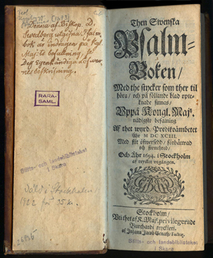
Jesper Swedberg’s hymnal
Bishop
Jesper Swedberg, commissioned by king Karl XI to produce a hymnal.
Published in 1694
Accused of pietism, confiscated to be destroyed
Notes:
In 1692 Bishop Jesper Swedberg of Skara was commissioned by the Swedish king (Hedvig Eleonora’s son) to produce a hymnal for the whole country. Together with two other pastors he finished the work in 1694 and it contained 482 hymns. The king quickly approved and sanctioned the hymnal. It was printed. But the hymnal was accused of being pietistic and not orthodox enough and it was confiscated to be destroyed.

Slide 24
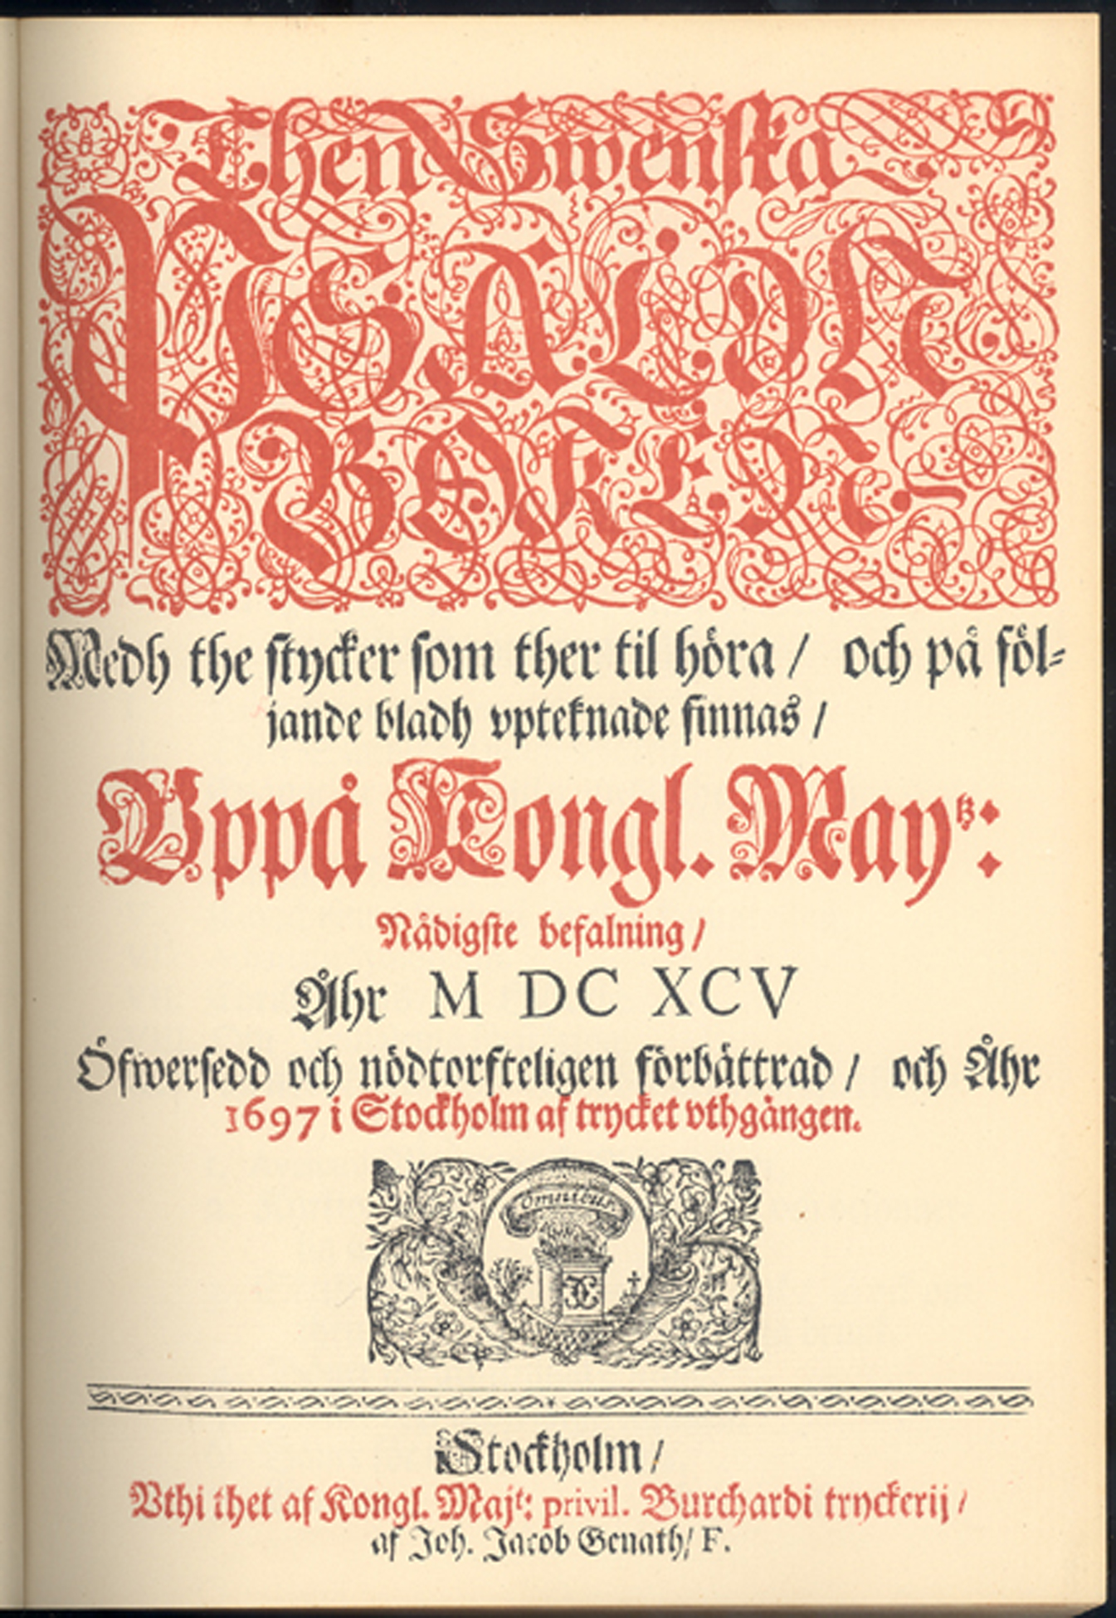
The 1695 hymnal
New committee got rid of 70 hymns
The first national hymnal was born
Hymnal with music edition in 1697
Queen Hedvig Eleonora worked on the music!
Notes:
70 hymns were excluded, some were changed. In 1695 the work was finished and the Swedish church now had its first hymnal which was used in the whole country.
Sweden was a great power in northern Europe at this time, because parts of Norway and all of Finland belonged to Sweden.
In 1697 the music for the hymnal was published. Queen Hedvig Eleonora is said to have done some work with the music for the hymnal.

Slide 25
What really happened …
Swedish colony ”New Sweden in Delaware
Desperate call for spiritual literature
Shipped to America where it could do no harm to Sweden!
Notes:
On the side: What happened to Jesper Swedberg’s hymnal? I have read that jealousy played a big part in the decision to confiscate it, maybe it wasn’t so pietistic after all.
The handwriting to the left states that this hymnal was confiscated.
At the same time there was a call for help from the Swedish colony “New Sweden” in Delaware. The Swedes there were in great need of spiritual literature.
It was quickly decided that Swedberg’s hymnal should be shipped to America, where it could do no harm to Sweden.

Slide 26
The impact of the 1695 hymnal
250 editions
1 500 000 copies before Sweden got a new hymnal
10 more editions, the last one in 1973
For people in general the hymnal was
THE book of religion,
more used than the Bible.
Notes:
The 1695 hymnal was published in 250 editions, a stunning 1 500 000 copies were printed, before Sweden produced a new hymnal 120 years later, and after that in 10 editions, the last one in 1973. It is by far the most influential devotional book in Sweden, and it has no comparison in other countries either.
Most people in Sweden couldn’t afford to buy a Bible. Instead they bought a hymnal. And maybe that wasn’t so bad when you consider what you could find between its covers.

Slide 27
Hymnal content
The 1695 set the standard:
1. The Catechism in hymns – 21 hymns
2. King David’s psalms in rhymed form – 90 hymns
3. Four canticles
4. 300 hymns for the different parts of the church year and Christian life.
5. Complete lectionary with epistle and gospel readings
Notes:
The 1695 hymnal set the standard for what should be included in a Swedish hymnal.
Between its covers you find this:
1. The catechism in hymns – 21 hymns
2. King David’s psalms in rhyme – 90 hymns
3. 4 canticles
4. 300 hymns for the different parts of the church year and Christian life.
5. Complete lectionary with epistle and gospel readings

Slide 28
Hymnal content continued
6. The liturgy of word and sacrament
7. The Small Catechism
8. The Bugenhagen compilation of the passion and resurrection of Christ and the destruction of Jerusalem
9. A small prayer book
10. The litany – which is a special prayer of the church used during Lent and the close of the church year.
Notes:
6. The liturgy of word and sacrament
7. The Small Catechism
8. The Bugenhagen compilation of the passion and resurrection of Christ, and the destruction of Jerusalem
9. A small prayer book
10. The litany – which is a special prayer of the church used during Lent and the close of the church year.
For people in general this hymnal became THE book of religion, more used than the Bible.
Ever since then the Swedish hymnals have contained a complete lectionary, the liturgy and the litany, the small catechism, a prayer book, the passion story besides all the hymns.

Slide 29
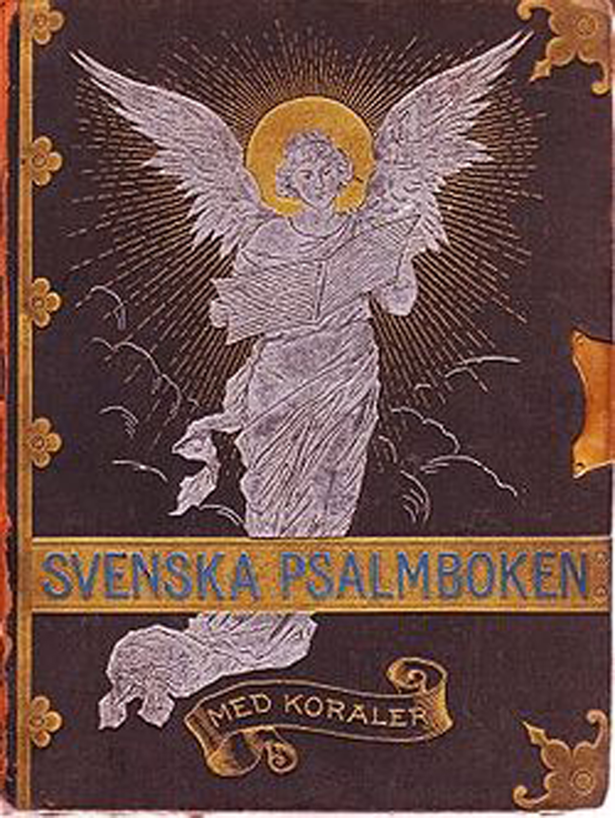
The 1819 hymnal
Bishop J. O. Wallin
”Wallin’s hymnal”
Good poetry influenced by romanticism and the enlightenment, moralism
Synergist: ”Do good and do your best, then God will do the rest”
Notes:
The next hymnal came in 1819, and was called “Wallin’s hymnal” after the most influential theologian/pastor/hymnwriter in the development of this hymnal.
There is a strong influence from the enlightenment and romanticism in this hymnal and morality and the good will of people are stressed. The general world view is much brighter than in the 1695 hymnal.
Wallin was a synergist and it can be seen in some of his hymns. One of the LBK pastors, Ingemar Furberg, sometimes would summarize Wallin’s theology like this: “Do good and do your best, then God will do the rest.”
Wallin had a reputation of being a very good poet. You can see in the hymns that nature and romanticism are reflected in many hymns. And still now, in Sweden we like to connect the variations in the seasons with our Christian faith and use them as imagery in our hymns.
There is an American connection here. Wallin actually once wrote an occasional poem called “Cheers for George Washington”!

Slide 30
The 1937 hymnal
The 1819 hymnal didn’t reflect clearly enough salvation by grace alone
1921 ”Nya psalmer” (New hymns) - supplement
The 1937 hymnal – J.A. Eklund
Anders Frostensson
Notes:
At the end of the 19th century the 1819 hymnal was criticized for not clearly enough presenting the Lutheran theology of salvation by grace alone. There was also a need for hymns covering other subjects, for example mission work. A replacement was needed.
In 1921 a supplement was printed: “New hymns”.
In 1937 it was replaced completely. Influential in producing the 1937 hymnal was bishop J. A. Eklund. A young pastor, Anders Frostensson, had a few hymns in this hymnal.

Slide 31
The 1986 hymnal
Part 1
1-325 Ecumenical hymnal for almost all denominations in Sweden
Part 2
326-700 Hymnal for the Swedish church
+ all the ”extras” for which the 1695 hymnal put the standard
Anders Frostensson – most influential
Notes:
The last Swedish hymnal was published in 1986. It has almost all the “extras” that you could find in the 1695 hymnal, but it is still very different.
The 325 first hymns are part of the “Ecumenical hymnal” a corporate work between almost all Christian denominations in Sweden and the other half is “the Swedish church” part.
Anders Frostensson was the most influential hymn writer for this hymnal.

Slide 32
My first blue hymnal
In 1961 – a connection between church and school
School hymnal
Hymns in public schools
Revival hymns from Bible Faithful Friends’ songbook
Notes:
1. My first blue hymnal:
Church and school have been closely connected in Sweden since the reformation and into the 20th century. My first blue hymnal was given to me when I began first grade in 1961. It was a special school hymnal but the only difference from the hymnal in the State Church was the purple slightly thicker inserted paper right after the hymns, which contained a list of hymns suited for learning in the schools.
I didn’t have any special relationship to this hymnal. It was “approved and sanctioned by the king” in 1937. The language seemed old to me then in 1961 and the music was boring. I was already used to the more lively melodies of the “reader”-songs in Bible Faithful Friends’ songbook, a large collection of spiritual songs from the revival times in Sweden at the end of the 19th century. The melodies were much more interesting to sing and people sang from their hearts.

Slide 33
My second blue hymnal
The Lutheran Hymnal
DMLC 1973
Notes:
2. My second blue hymnal:
Dr. Martin Luther College auditorium, September 1973. A newly purchased “Lutheran Hymnal” from the DMLC bookstore. I now sang many of those “boring” melodies from my first blue hymnal in a completely new setting, but they were a bit different. Not just quarter notes, there were some half notes and eighth notes as well.
Young people, singing from their hearts in four part harmony rich texts from our Lutheran heritage. Everyone participated in the songs of the liturgy at St. John’s down the hill. I began to like it all.

Slide 34
My third blue hymnal
The 1695 hymnal with music!
Notes:
My third blue hymnal is my newest one but also the oldest one. It takes us back to that golden age of Lutheran Hymnody in Sweden and the first Swedish hymnal. It’s been in my house for a few months. It’s the hymnal from 1695, published with music in 1697.
Paging through it I found the one and only hymn we had to learn in confirmation class, “Jesus is my friend, the best one”, AND not with the music from my first blue hymnal, with boring music, but with the NEW fresh melody I learned much later! So the new melody was actually the old melody.

Slide 35
My first red hymnal
The situation in 1974 when the Lutheran Confessional Church – LBK – was formed
The 1937 hymnal oldfashioned
Competition from 19-th century revival songs
Per & Kjerstin Jonsson
Four hymnal supplements
”Luthersk Psalmbok”
Notes:
The situation in 1974 when the Lutheran Confessional Church (LBK) was formed.
My first red hymnal
The 1937 Swedish hymnal seemed old-fashioned. At the same time one of our pastors, Per Jonsson, wanted to distance LBK from the pietistic type of spirituals songs that were so popular among many of us. He and his wife Kjerstin produced a supplement to the 1937 Swedish hymnal , which they called “Praise the Lamb”. It contained 117 hymns, many of them taken from the 1695 hymnal with slightly modernized language. But still, one other LBK pastor said about this hymnal, that even though he was happy for this alternative, he could “cry blood” when he read the very old language in some of the hymns.
A couple of years later, Per and Kjerstin published their next “supplement” “Praise to you, oh Christ”, with another 128 hymns. The language was better in this supplement. They were bound into one book called Luthersk psalmbok (The Lutheran Hymnal). In 1984 and 1989 two supplements to Luthersk Psalmbok were published and in 1991 all original four parts were published in one hymnal. The four parts had not been reorganized so you find for example Christmas hymns in four different places. Also the numbering remains the same: 1-148 and 701-974 for the hymns that originally were supposed to be supplements to the Swedish hymnal from 1937.
No one else in LBK had any influence on this hymnal. It was the work of two people exclusively. The copyright belongs to their daughter and she never permits printing of any of the copyrighted hymns, not even if you pay for them. I think the only churches that use this hymnal regularly is LBK and ELBK, 300 people.
About 100 of the hymns are in regular use in our church. There are some you just don’t want to lose and some you don’t ever want to sing and some that don’t fit the music that is suggested for them.

Slide 36
My second red hymnal
Psalms!
New modern hymns
Devotional booklet
Psalm singing made possible
Notes:
My second red hymnal
My second red hymnal has 623 hymns and 61 psalms. Christian worship. I have paged through it many times and played the melodies of the ones that seem the most interesting. On the inside of its covers I have written down the numbers of the hymns I would like to have in Swedish.
Because of the shortage of pastors in LBK, families sometimes have to have reading services at home. Right after I got Christian worship I put together a “Devotion booklet” with a simple liturgy for reading services and I included some of the psalms from CW so that families could read them responsively.
This hymnal also triggered my interest in singing the psalms again. I asked the musician in our church in Piteå about it and he said that he didn’t think that was possible. It would be too hard. I then prepared psalm 98 with Swedish text and showed it to him. “Well, that doesn’t look too hard,” he said. And so it started. I introduced psalm singing at a youth camp. This was probably in 1997 or 1998.
Since then we have adapted about 40 psalms to Swedish. Some of our congregations use them every Sunday and others now and then.

Slide 37
My third red hymnal
The Swedish Hymnal 1986
Special ”LBK” index
Notes:
My third red hymnal
For some reason, which I don’t remember I bought a copy of the newest Swedish hymnal from 1986. Maybe it was because there were people in our church who didn’t want us to adopt the red “Lutheran hymnal” as the official LBK hymnal before evaluating the Swedish hymnal. Studying it I realized that 92 of the hymns were the same as in the Lutheran hymnal. I compared the texts. Some of them were better in the Swedish hymnal and some in the Lutheran hymnal. Then I found all these good hymns, which were not in the Lutheran hymnal.
We were three people, myself, Seth and Birgitta Erlandsson, who read through the whole Swedish hymnal and marked all the hymns we could use in the LBK. Altogether about 450! An LBK hymn list was prepared which listed only those hymns we can use and congregations, that purchased this hymnal, could insert this list in them. Now three congregations use this hymnal as their main hymnal and three use the Lutheran Hymnal.

Slide 38
Hymnal choices in LBK
1 uses Luthersk Psalmbok (LP) and Bible Faithful Friends’ songbook
1 uses LP + various songs gathered in a binder
3 use The 1986 hymnal and liturgy booklets with extra hymns
1 uses LP and liturgy booklets with extra hymns
1 uses only the Trinity liturgy booklet
Notes:
Hymnal choices in LBK
There has never been a consensus on which hymnals to use in the LBK. Two congregations have used the Swedish hymnal 1937 as their main hymnal and the Lutheran hymnal as a supplement. Other congregations have used the Lutheran hymnal as their main and only hymnal and one has used Bible Faithful Friends’ hymnal as supplement. Now three congregations use the Swedish hymnal 1986 as their main hymnal with additional hymns in the liturgy booklets.

Slide 39
What did the survey say?
Most people are happy with the types of hymns we have
They want a mix of Lutheran hymnody, traditional revival songs and some modern hymns
More variation
Guitar chords to all melodies!
No strong yearning for praise songs
? How to get the young more involved in singing?
Notes:
What do our people know and think about hymns and liturgy?
So, what do the people in our church think about the liturgies and hymns we use in our church. What do they know about the liturgy? What hymns do they like, and what hymns do they miss? How much training do our pastors have in liturgy? I did a little survey among our people to find out:
The hymns: Generally people are happy with the types of hymns we have. There is no strong yearning for a lot of praise songs of the type evangelicals have in their services. People want a mix of Lutheran hymnody, the traditional “reader” songs and modern hymns with more modern music. In some congregations it is necessary to have hymns, that can be accompanied on guitar. Guitar chords on all hymns! Older people have many more favorites than young people.
At a youth camp a few years ago the leaders introduced many new modern hymns and praise songs but in the survey afterwards the youth wanted more of the traditional Lutheran hymns.

Slide 40
…about the liturgy
Our pastors have no training in liturgy
Liturgy – God is a friend of order
Our liturgy is easy to follow and understand
Liturgy – to help visitors
Liturgy – so that all important parts are present in every service
Liturgy – ancient origin
Notes:
The liturgy:
Let’s start with the pastors: All of our pastors say they have little to no training in liturgy. They have learnt along the way.
The lay people: A handful of laypeople know something about the ancient origin of the liturgy. Some understand that the liturgy helps us to focus on the right things in the church service. Many think it is there for the sake of good order and so that visitors will know what is going on. Most people think our liturgies are easy to follow.

Slide 41
Working with hymns
Hymn writers
Translation team – informal LBK hymn group
Persistence and patience
The ”Net hymnal”
Copyright rules – Copyright Rules!
Notes:
Where are we going from here?
While working with people who translate Christ Light into Swedish I noticed that we have a few people in our church who are good at rhyming and I began sending them English and German hymn texts for translation. This is how it all started. We have translated several hymns from Christian Worship and the supplement. For example we received permission from Thankyou music to translate “In Christ Alone”, even though there were two Swedish translations already, but they were not very good, one of them was more like a “google translate”-version than anything else. Work with the psalms is also still continuing.
This is how we work: One person is the main translator of the hymn. She makes a draft, which is sent to the others and we come up with suggestions for changes. This procedure usually inspires the main translator to new ideas for rhymes and expressions. We continue until everybody is happy with the result. The main translator has the final say. This way we are able to make new translations from the original of well-liked hymns in the Red Lutheran hymnal, make a modern translation and use them without violating copyright rules. We have also translated more than 20 hymns from CW.
Another resource is the “Large net-hymnal” (Stora nätpsalmboken) operated by a teacher/organist with a special interest in hymns. It is a collection of more that 1000 hymns, old and new, and often new translations or alterations to more modern language. Here we have found a lot of good material. And the owner of the site generously gives us all the material we want to use!
A spider in the web is needed, somebody who can pull the right strings to get the work done.
I must admit that for a long time we were very ignorant of copyright rules but we have learned. For many years we had three songs written to music originally composed to other texts. When we realized we were violating copyright laws we asked for permission but we didn’t get it. Then I sent the texts to various musicians who compose hymn music. But I didn’t get any response. Either they thought the rhythm of the text was strange or they immediately understood which melody the text was written for and just gave up because those melodies are so famous in Sweden.

Slide 42
Utan Guds Son…
(Without God’s Son…)
Text: S. Erlandsson
Music: G. Hedkvist
(4) Lycklig och glad, vem är väl det
i denna vår värld så full av nöd?
Endast Guds barn, som tror Guds nåd,
att all vår synd är förlåten.
Herre du ser vår nöd,
endast hos dig är liv.
Herre, vi prisar ditt heliga namn.
Translation: Who is happy and content
in this our world so full of distress?
Only God’s children who believe in God’s grace,
that all our sins are forgiven.
Lord, you see our distress, only in you there is life
Lord, we praise your holy name.
The audio file for this hymn is available on the 2014 worship conference site.
Notes:
What to do? Well, I thought, why not do something just the opposite to the original melody? I tried that and then I took the melody with chords to my organ teacher who gave me some good advice. Two of the texts now have their own new music. And if I could come up with a melody I hope that will inspire those who are true musicians in our church to compose much better melodies to other texts than I will ever be able to do.
Let’s listen to one verse from one of the two hymns we have with both text and music produced within the LBK. The recording is from our conference this summer.

Slide 43
How we spread new hymns
Camp booklets
Include liturgies and hymns
Booklets to use at Bible studies
Notes:
How do we spread the new hymns?
New hymns are usually spread at our annual summer camps because we usually publish a camp booklet with hymns and liturgy for these camps. We also put those that are public domain on our website.

Slide 44
Working with liturgy
LBKs first handbook for church rites
Notes:
The liturgy
When LBK started pastor Per Jonsson produced a “Handbook for Church Rites” for the pastors, which included a lectionary and prayer of the day and the rites of Divine service, baptism, wedding, funeral. The musician could use the handbook for music from the Swedish church. But there was nothing for the people in the pews.

Slide 45
How it started…
Piteå – help visitors
1999 – John Vogt
Trinity season liturgy, music and pew edition
Christmas, Lent and Easter liturgies
Notes:
Piteå in the 1990-ies: Now and then we had visitors to our services in Piteå. But we didn’t have anything to put in their hands so they could follow the service. Most of these people were accustomed to the traditional services in the Swedish church and ours wasn’t much different. But we realized we needed to make a small agenda of the service to help people.
In 1999, when we received an American pastor to help us with training future pastors, John Vogt, it became even more evident that something had to be done with the liturgy. After the installation service in Ljungby he and his wife Sandy said that they didn’t have a clue to what was said or going on in that service. And they had studied Swedish! Nobody had prepared anything for them so they could understand the order of the service. Imagine being installed into an office without knowing what the people are saying! Something had to be done quickly.
I studied Christian Worship and compared it with the Swedish liturgies. Some ideas emerged where I could use some aspects in your liturgies and incorporate them in the Swedish liturgy, for example, the use of psalms, verse of the day, the song of Simeon. At the annual summer camp I gave each LBK pastor a copy of a “pew edition” and “musician edition” of a liturgy for the “Trinity season”. Soon most of our congregations used this order of service. Three more booklets followed with liturgies for the Christmas, Lent and Easter seasons. Here I included both psalms and hymns.

Slide 46
New influences…
2000 Norrköping, Tim and Sara Buelow
2006 Norrköping - no hymnal, another liturgy
More influenced by WELS
New series of liturgy booklets
Notes:
New influences in liturgy
We received new influences regarding liturgy when pastor Tim Buelow served in Norrköping for two years. He and his wife Sara used more WELS material than we did in the other congregations. They also translated some hymns.
When my husband took the call to Norrköping in 2006 we came to a congregation, which was used to a printed order of service with the hymns inserted every Sunday. They had no hymnals. Because of what we know about copyright now it wasn’t possible to continue that way.
Based on the liturgy used in Norrköping I started all over and produced new booklets, with a modernized liturgy, for the four seasons of the church year. The congregation started using the Swedish hymnal. They were unfamiliar with the Lutheran Hymnal. I finished three seasons but for the Trinity season I simply didn’t have the time to compile both hymns and psalms.

Slide 47
2011 Conference booklet
Trinity season
Gathering rites on Baptism and the Word
19 psalms
61 hymns
Notes:
In 2011 I was part of the planning committee for our annual summer camp. At the same time Norrköping needed a more complete Trinity booklet. The Church board gave me permission to combine this work with doing a camp booklet.
Inspiration came from CW supplement which I received at the Worship conference in 2008. I also wanted to see if it is at all possible for a small church to produce a hymnal. The church board gave me permission to produce this “Trinity season – liturgy and hymns” with 120 pages.
It contains the
Gathering rite on Holy Baptism –the baptism hymn (Baptized into your name most holy) was translated into Swedish for the first time ever.
Gathering rite on the Word of God – we added verse four to the familiar hymn.
A Trinity liturgy of the Word and Sacrament. Here we included “Prayer and Praise from CW’s Service of word and sacrament.
We used the prefaces and “Prayer of Thanksgiving” from “Divine service II” in CW supplement.
There are 19 psalms and 61 hymns. When choosing hymns I focused on gathering those we have translated, finding hymns that have better translations than what you find in the Swedish “Lutheran hymnal”, and hymns which we have learned to love because of our close fellowship with LBK in Norway. Lutheran heritage, fellowship heritage, Scandinavian heritage.
So, as you can see, we get a lot of inspiration from your hymnals. We don’t create anything completely new, it’s more like a pick and choose exercise.
I spent a lot of time on copyright issues. Some hymns had to be excluded because we didn’t get permission to use the music.
One hymn had 7 copyright holders! After contacting all seven we got permission for free! I called pastor Steven Starke. Besides giving permission he had CPH send me the Lutheran Service book and Jaroslav Vajda’s and his own hymn booklets for free!
Besides the “pew edition” I also made a “music edition” with the liturgy and one with psalms and hymns for the organist. The meditations on the Catechism were gathered in a small devotion booklet. By this work I think I have proved that our church is capable of producing a hymnal. After all it only took me a few months even though I worked full time as a teacher at the same time. I also used part of my vacation.

Slide 48
The future
We can make a main hymnal for LBK
Other hymnals = supplements
What we need to do:
Lectionary revision
Prayer of the day revision
Hymn gathering
More psalms
Liturgy enrichment
”Get on the WELS train” + attach Swedish wagons
Notes:
The future!
God has blessed the LBK when it comes to hymns and music! We have a great heritage. We have good translators and hymn writers. We now have people interested in the liturgy.
So, how do we continue?
At LBKs business meeting this summer a proposal to produce a hymnal for LBK was passed. It is good timing because we can make use of how WELS is working towards a new hymnal.
This is what we need to do:
A complete study and evaluation of the lectionary so that the most suitable texts are chosen for each Sunday and theme. Three texts every Sunday in a three years series. One theme for each Sunday.
A complete revision of the prayer of the day.
A study of which hymns are used on different Sundays in our church. What types of hymns do we lack?
Encourage our people to tell us which hymns are their favorites for every season and certain Sundays and festivals. Other favorite meditational hymns.
More work with liturgy, morning praise, compline and so on.
More work with psalms and revising their texts to the best Swedish Bible translation. We need to get on the “WELS train” and attach a Swedish wagon.

Slide 49
Examples: 1942 liturgy
Holy holy holy is the Lord Almighty.
All the earth is full of his glory.
The Lord is in his holy temple. His throne is in heaven. He also comes to those who have a humble and contrite spirit. He hears the sighs of those who repent and turns to their prayers.
Notes:
There is a need for different liturgies and a modern language. An example: The first liturgies I made followed closely the Swedish church liturgy from 1942. It begins like this:
Holy holy holy is the Lord Almighty. All the earth is full of his glory.
The Lord is in his holy temple. His throne is in heaven. He also comes to those who have a humble and contrite spirit. He hears the sighs of those who repent and turns to their prayers.
There is nothing wrong with this, but for me, being brought up in a State church setting, this means: God is in the church building on the hill. When I left the Swedish state church in 1973 I was told this also meant that I left the holy Christian Church, which God had intended for Sweden. But liturgies in other Lutheran Churches begin differently, so I was curious about why the beginning of the service was so different in Sweden. Maybe it was an expression of the distance between the laypeople and the pastors and officials in Sweden as a church and state combined into one unit?
This wording was not possible to change immediately, when I made the first attempt with liturgy in 1999.

Slide 50
Examples: 1695 liturgy
Dear friends, brothers and sisters in Christ Jesus. We have gathered here to celebrate the divine service, thank God for all his divine blessings and also to pray for what we need in life both for our body and our soul, and we realize that we are sinners and want to be freed from our sins. Therefore we want to kneel and humble ourselves before our heavenly Father with heart and mouth and confess that we are sinners…
Notes:
How did the service begin back in 1695 when the first Swedish hymnal was published? Listen to this:
Dear friends, brothers and sisters in Christ Jesus. We have gathered here to celebrate the divine service, thank God for all his divine blessings and also to pray for what we need in life both for our body and our soul, and we realize that we are sinners and want to be freed from our sins. Therefore we want to kneel and humble ourselves before our heavenly Father with heart and mouth and confess that we are sinners…
So something happened along the way here.

Slide 51
Our new liturgy
Inspiration from CW
Christmas – Pentecost: “The Lord is among us”!
Trinity season: The Apostolic blessing
Liturgy trends go beyond fellowship borders
Notes:
Because of pastor Tim Buelows work with liturgies in Norrköping we could make some changes in the liturgy there. The new Norrköping liturgies begin either with: The apostolic blessing for the Trinity season when we focus on the Christian life, or “The Lord is among us!” for the festival seasons when we focus on Christ’s life on earth. In a New Testament setting I think we can apply what Jesus said to the woman at the well: “An hour is coming when neither on this mountain nor in Jerusalem, shall you worship the Father.” Our LBK settings in Sweden are humble houses or rented spaces instead of landmark church buildings. And we are sure he is among us even when we just meet in homes.
WELS has provided us with very good resources but sometimes I also look at what happens in the Swedish church. They are in the process of modernizing their liturgies and they have a lot of expertise in language. The pitfalls are the theology: When they pray “Let your kingdom come” in the prayer of the church they mean something completely different from us – just earthly peace and equality. So what do you do when a heretic church uses the same words but they mean something different?

