Slide 1
Accessibility 101: Overcoming Physical Barriers in Worship Spaces
Todd Dvorak ^{AIA}
2017 National Conference on Worship Music & the Arts
JUNE 14 & 15, 2017

Slide 2
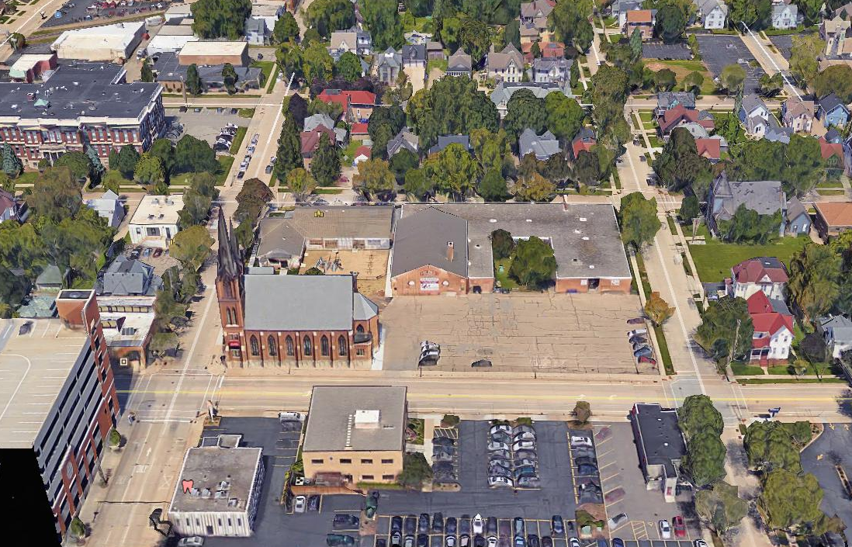
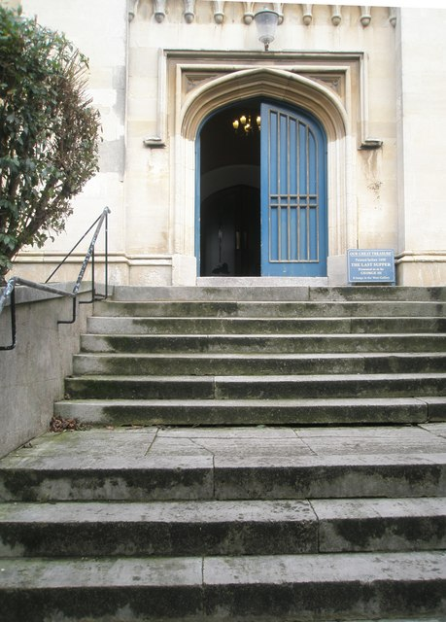
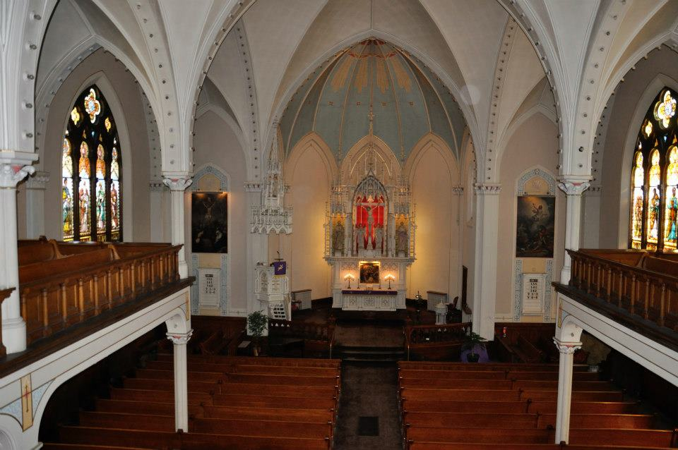
Introduction

Slide 3
Introduction
65% of those without disabilities attend religious services at least once per month
47% of those with disabilities attend religious services at least once per month
73% of those with disabilities say their faith is very important to them
55% of those without disabilities say their faith is very important to them

Slide 4
Discussion focus
Code requirements
Elements of accessibility
Parking
Entrance
Worship space
Bathrooms
Insight to share at your home congregation

Slide 5
Expectations
Americans with Disabilities Act, 1990
State Building Codes (International Building Code, Chapter 11), tells us WHAT
Americans with Disabilities Act Accessibility Guidelines (ADAAG), tells us HOW
American National Standards Institute (ANSI, Section A117.1), tells us HOW
What is in effect varies from state to state

Slide 6
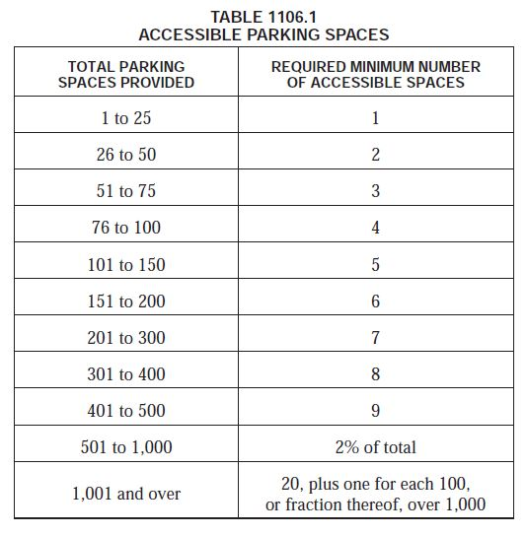
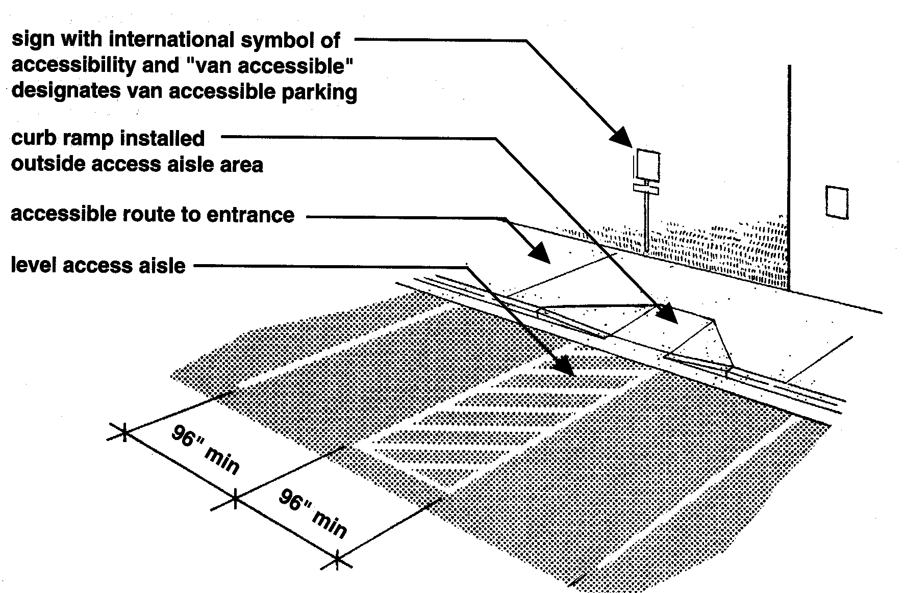
Building codes– WHAT vs. HOW example
International Building Code, Chapter 11– identifies what quantity of accessible parking stalls are required
ADAAG and ANSI tells us how to design each accessible parking stall

Slide 7
Expectations
Is a church required to follow the Americans With Disabilities Act?
Is any part of your building shared with the public or rented by outside groups?
Are you renovating or building a new building?

Slide 8
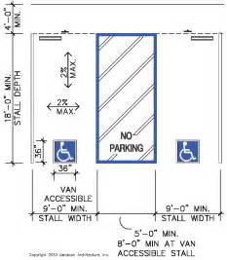
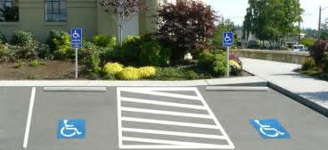
Components on the accessible route
Accessible parking spaces

Slide 9
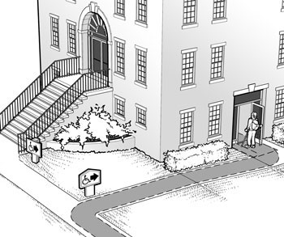
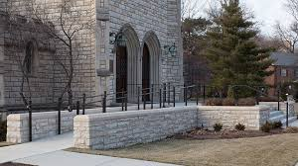
Components on the accessible route
Entry: Ramps
1:12 Slope maximum
Alternative accessible route

Slide 10
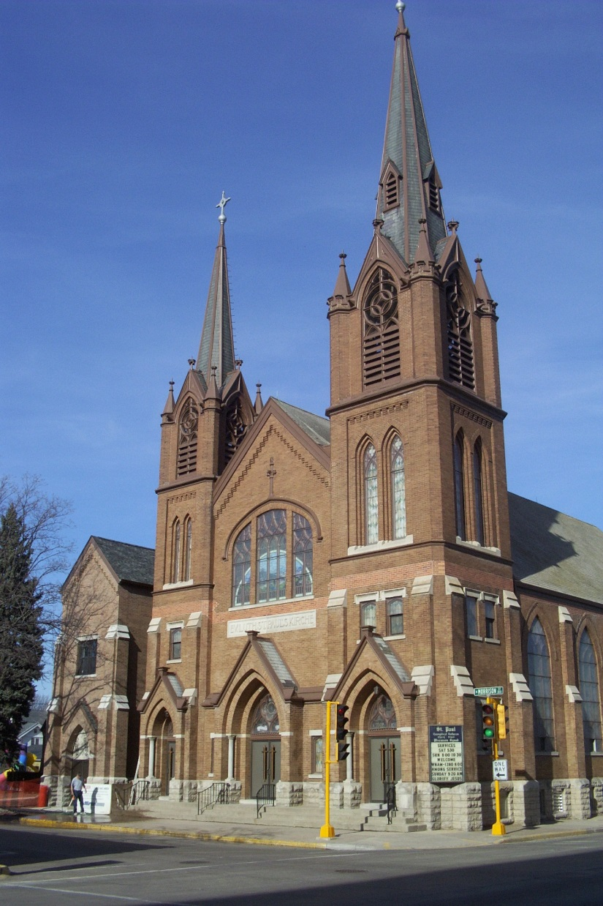
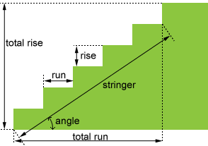
Components on the accessible route
Entry: Stairs
7” maximum rise
11” minimum run

Slide 11
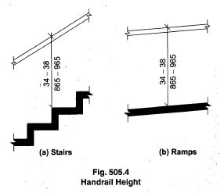
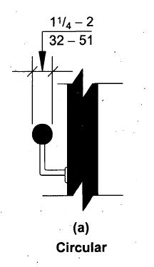
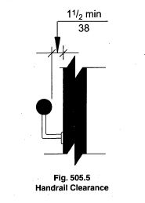
Components on the accessible route
Handrails
6” vertical step
clearance and diameter
Top of handrail height

Slide 12
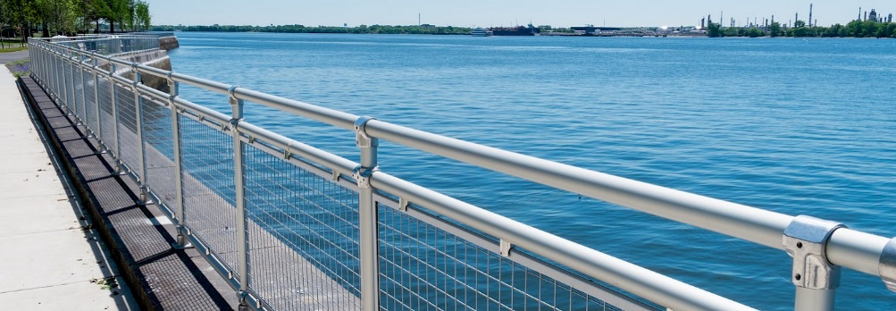
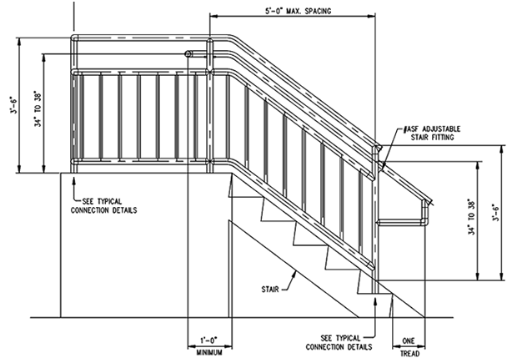
Components on the accessible route
Guardrails
Handrails versus guards
30” vertical separation

Slide 13
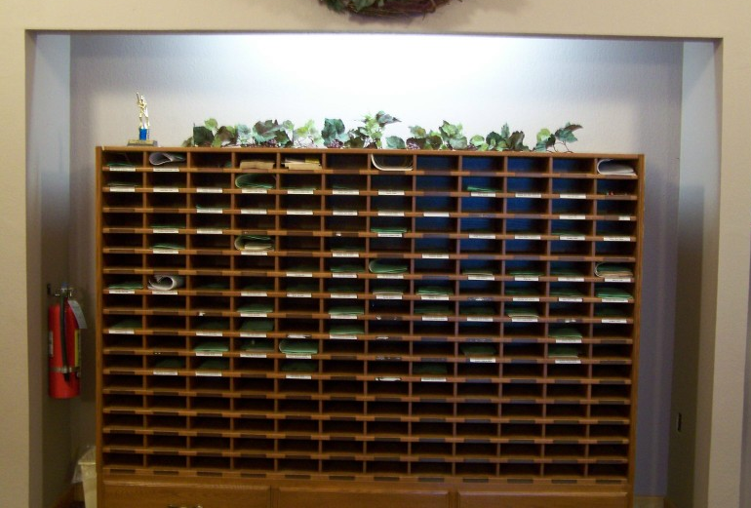
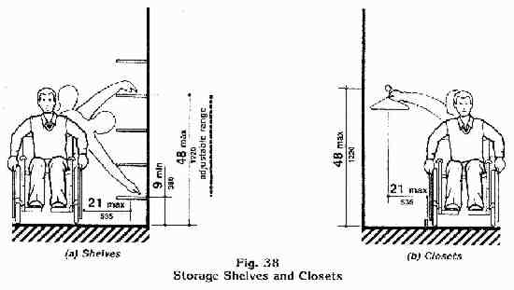
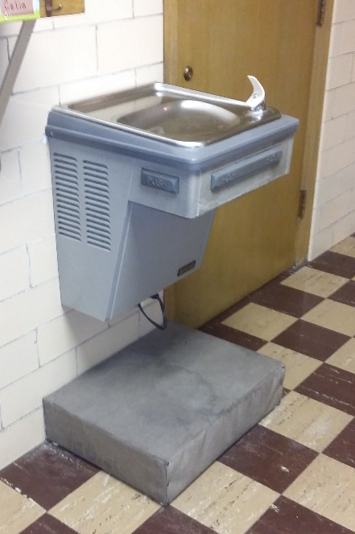
Entering the Building
Narthex
Mailboxes
Coat Racks
Drinking Fountain

Slide 14
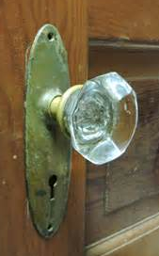
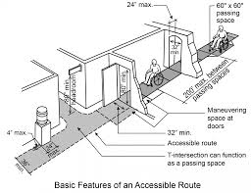
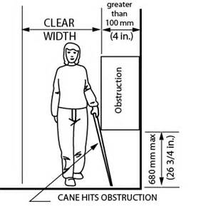
Moving Through the Building
Narthex
Doorknobs
Protruding objects
Door widths

Slide 15
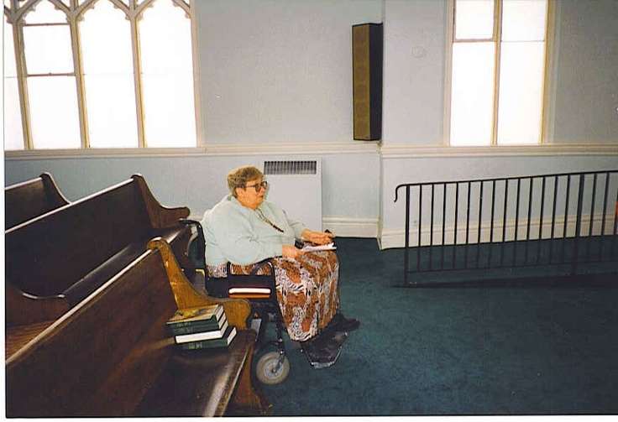
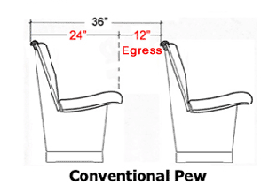
Worship
Nave
Pew Cuts
Pew Spacing– assumes no more than 14 persons in one pew

Slide 16
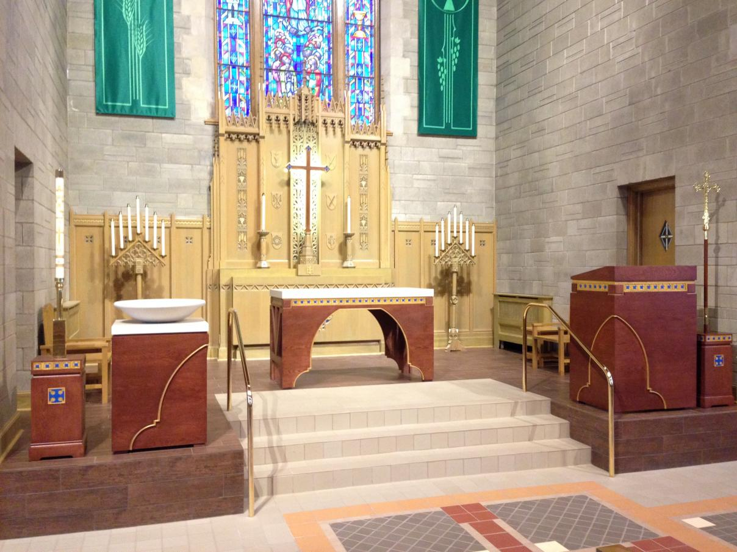
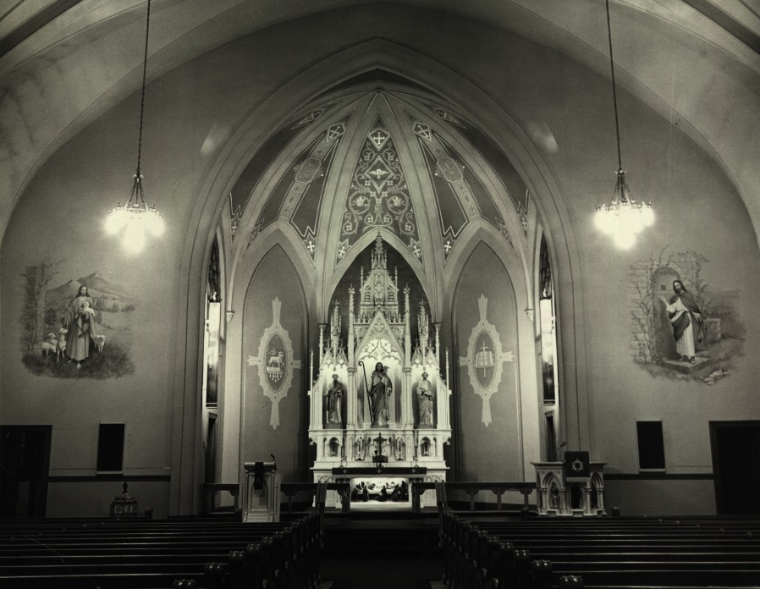
Worship
Chancel
Baptismal Font
Lord’s Supper
Pulpit

Slide 17
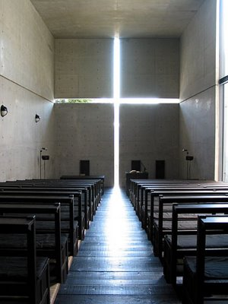
Worship
Chancel
Lighting
Large Print Bulletins
Screens?

Slide 18
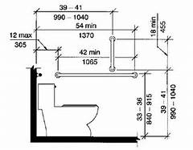
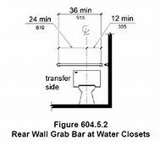
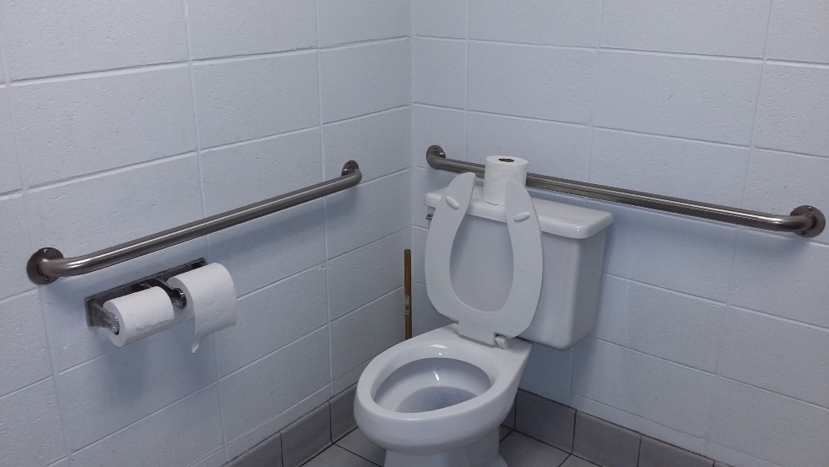
Accessory spaces
Bathrooms – water closets
Grab Bars
Sizes

Slide 19
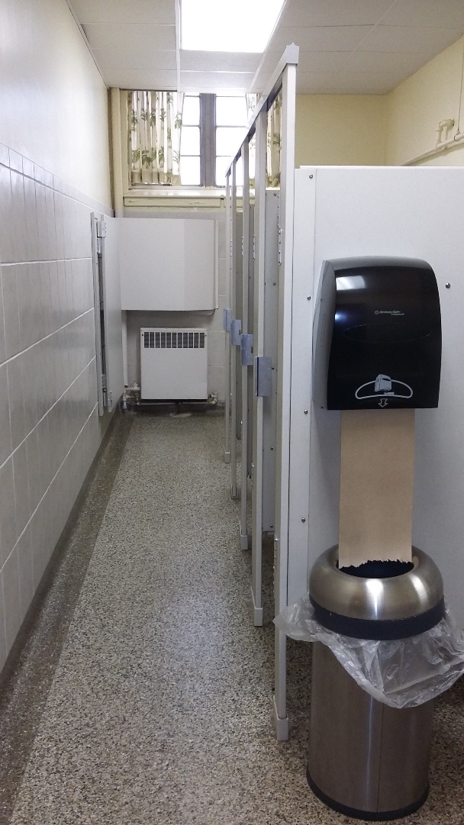
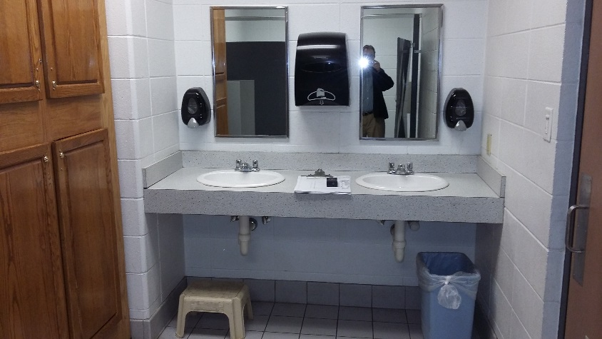
Accessory spaces
Bathrooms– sinks and accessories
Accessories
Soap dispenser
Paper towel dispenser
Mirror Height
Sink Height

Slide 20
Areas for improvement
Entrance
Provide handicapped marked stalls closest to accessible entrance
Keep all surfaces smooth– no uneven surfaces
Handrails when needed
Narthex / Welcome
Large print bulletins
Coats and mailboxes at lower heights
Worship
Location of Baptismal Font
Distribution of Lord’s Supper
Bathrooms
Grab Bars, even in non-compliant water closets
Non-slip flooring
Adjust heights of sinks,

