Slide 1
Different Styles of Psalmody
for the New Hymnal and Psalter
Grace Hennig and Dan Witte
Members, Psalmody Committee

Slide 3
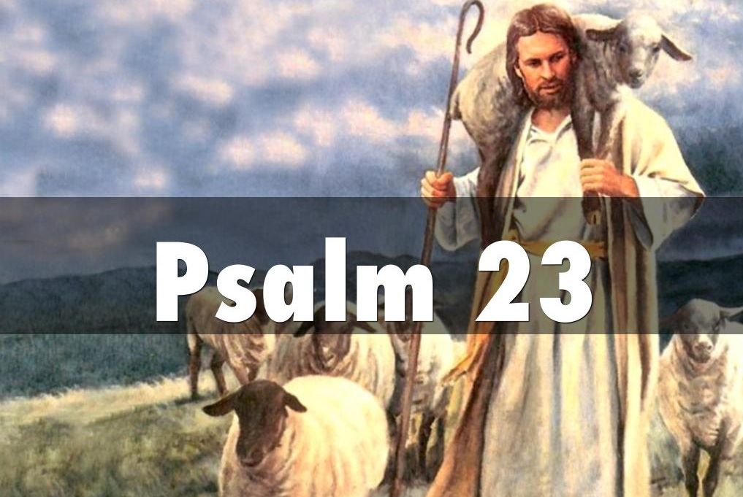

Slide 4
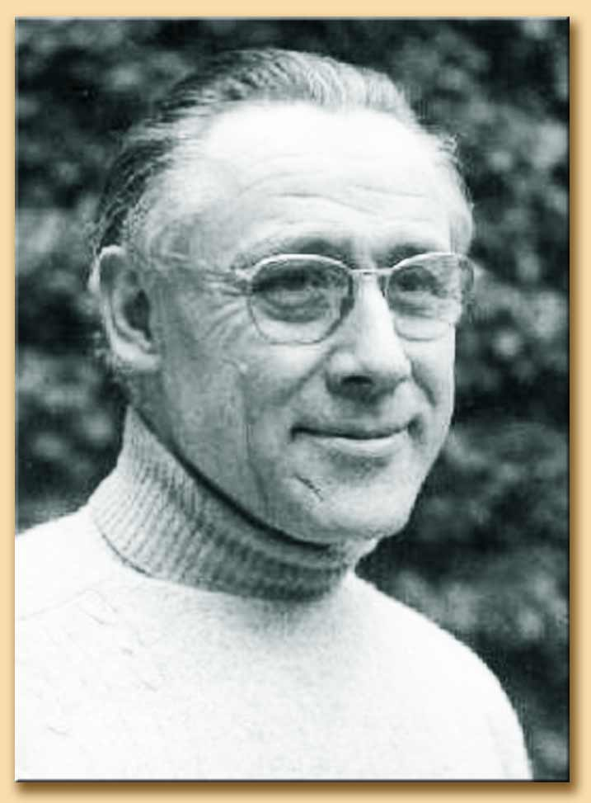
Joseph Gelineau (1920-2008)
“Accentual Verse”
Notes:
Joseph Gelineau (1920-2008) / Baa, Baa, Black Sheep
https://en.wikipedia.org/wiki/Accentual_verse

Slide 6
Use of the Psalm in the Lectionary
Easter 4: Good Shepherd Sunday – Year A, B, C
23rd Sunday after Trinity – Year A
11th Sunday after Trinity – Year B
Funeral Service

Slide 7
Notes about this selection
About Gelineau Psalmody - GIA
Each measure contains one large beat
Stressed and unstressed words/syllables
Division of the text within the large beat

Slide 8
How the psalm can be sung in worship
Refrain introduced
Refrain repeated and all following refrains by all
Soloist on verses at first
Eventually the hope is congregation can sing verses

Slide 11
Use of the Psalm in the Lectionary
14th Sunday after Trinity – Year A
Service of the Word

Slide 12
Notes about this selection
About Gospel-style singing
Roots and Rhythms
Call and Response
Tommy Dorsey - Late 1930’s: Gospel Blues
Choir’s role

Slide 13
How the psalm can be sung in worship
Refrain by choir or soloist
Repeat refrain (at first)
Choir or soloist on the verses - congregation can try

Slide 16
Use of the Psalm in the Lectionary
Reformation (minor festival) – Year A, B, C
13th and 19th Sunday after Trinity – Year B

Slide 17
Notes about this selection
About Anglican Chant
Watch for the “thump!”
Most expressive; most difficult
The Psalms Made Singable

Slide 18
How the psalm can be sung in worship
Melody only with organ accompaniment
Choir in 4-part with organ or without
Cong. in 4-part with/without accompaniment.

Slide 20
No recording of this psalm

Slide 21
Use of the Psalm in the Lectionary
Ascension – Year A, B, C

Slide 22
Notes about this selection
First Double tone in packet
Picked for the field test
Responsorial (anything with refrain) chant:
Why do we use reciting tones, anyway?

Slide 23
How the psalm can be sung in worship
Typical CW type of psalm but double tone
What are your ideas for this psalm?

Slide 24
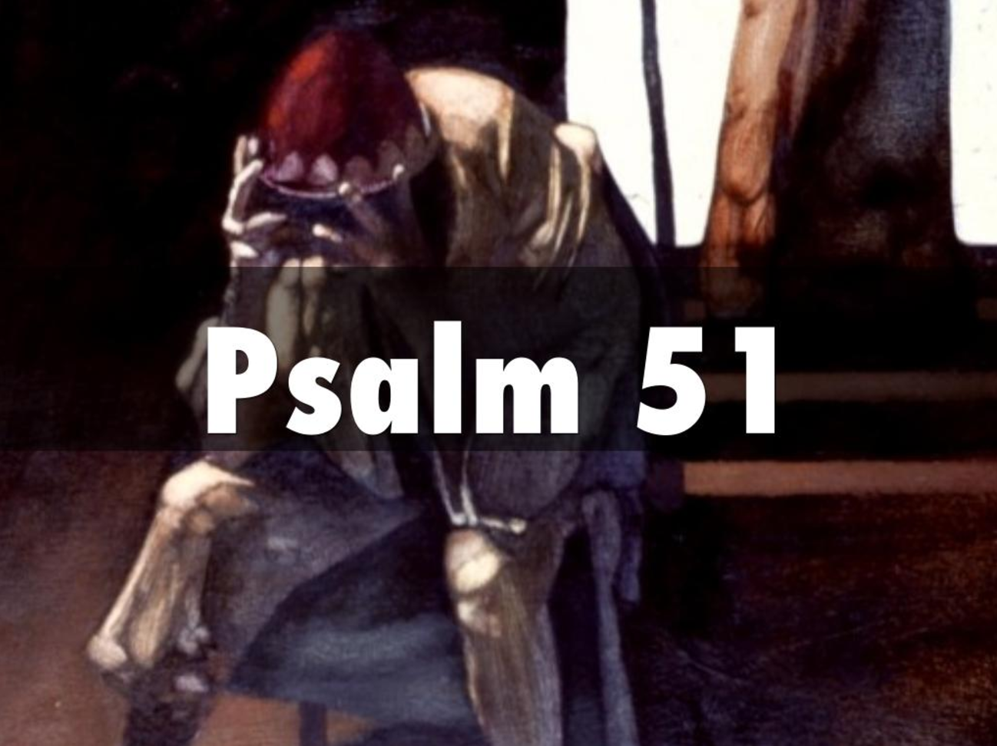

Slide 25
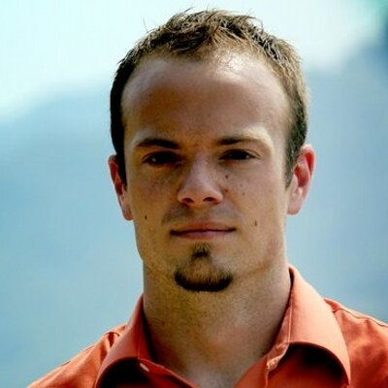
Notes:
Mark Haas

Slide 27
Use of the Psalm in the Lectionary
Ash Wednesday – Year A, B, C
19th Sunday after Trinity – Year C

Slide 28
Notes about this selection
Responsorial psalm singing
Organ or piano accompaniment

Slide 29
How the psalm can be sung in worship
Options for the refrain
Options for the verses

Slide 31
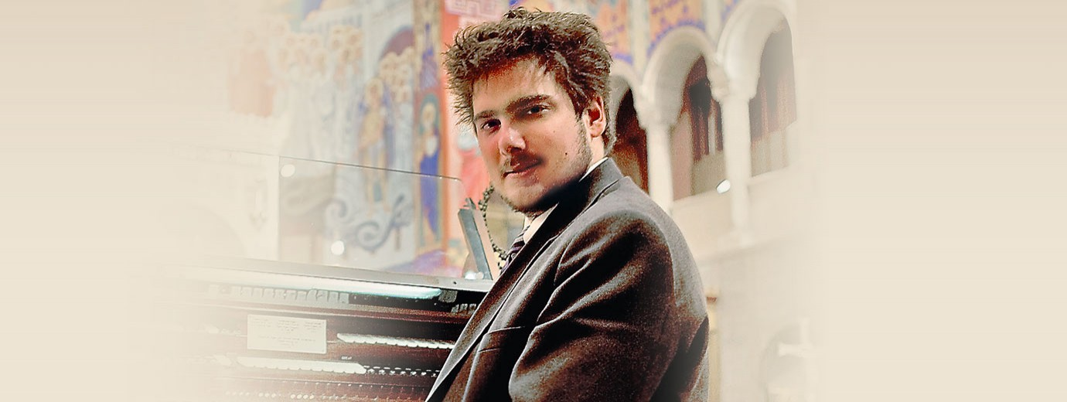
Notes:
Luke Mayernik

Slide 33
Use of the Psalm in the Lectionary
Epiphany 8 – Year A
9th Sunday after Trinity – Year A
Epiphany 3 – Year B
4th and 24th Sundays after Trinity – Year B
8th and 22nd Sundays after Trinity – Year C

Slide 34
Notes about this selection
Tunes that transcend style
Pairs well with Lasst uns erfreuen
Can you think of other examples?

Slide 35
How the psalm can be sung in worship
Verse and refrain approach or sing all
Melody-focused

Slide 36
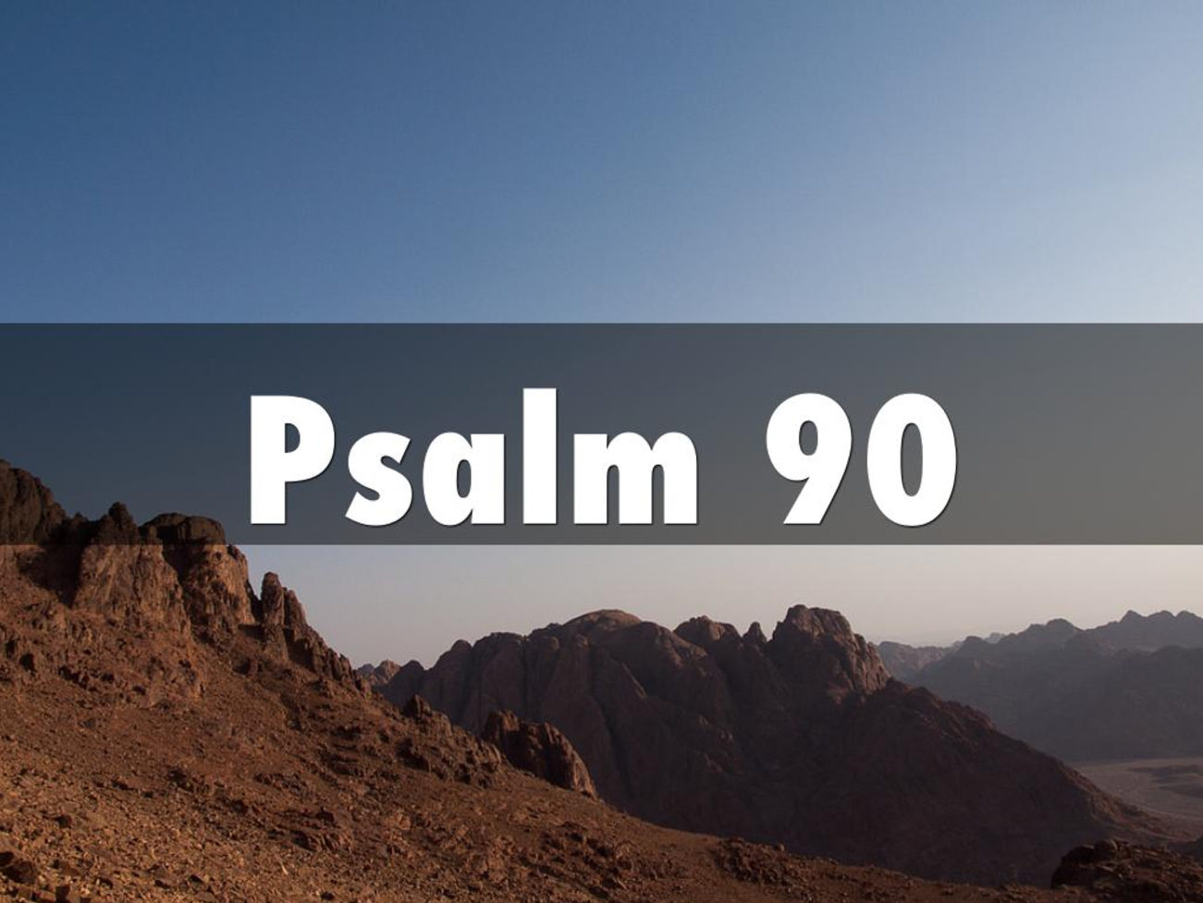

Slide 37
See handout for Psalm 90

Slide 38
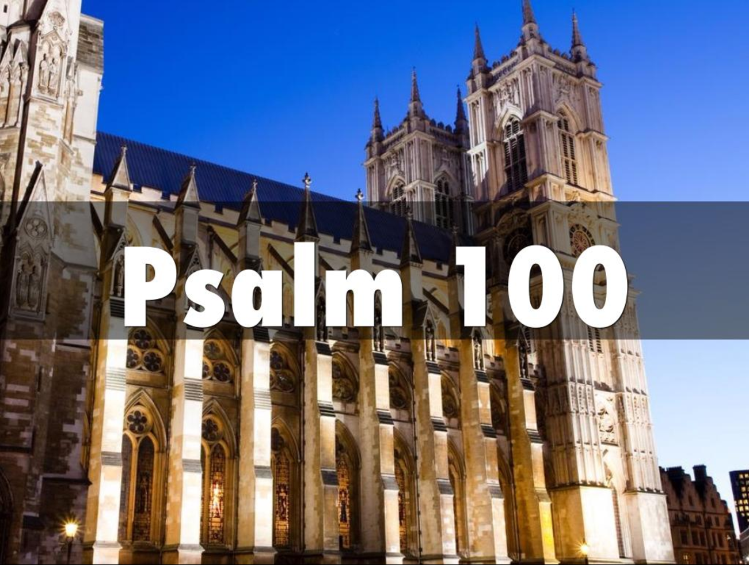

Slide 39
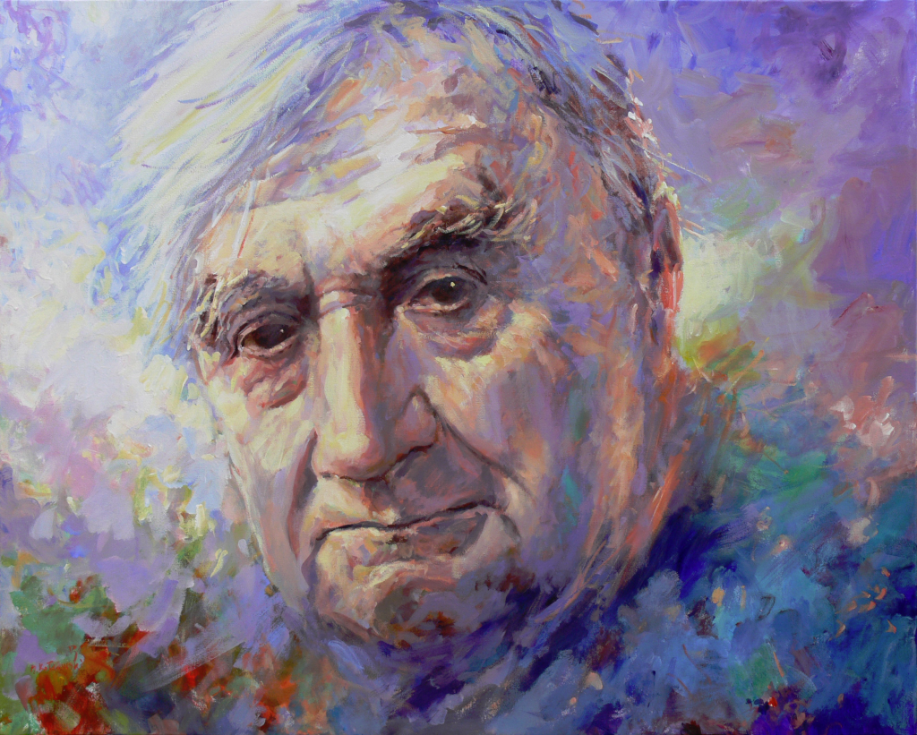
Notes:
Ralph Vaughan Williams (1872-1958), setting copyright 1953

Slide 41
Use of the Psalm in the Lectionary
6th Sunday after Trinity – Year A
Thanksgiving

Slide 42
Notes about this selection
Expanded settings of Psalms
Queen Elizabeth II coronation
Elizabethan language
Psalm paraphrases
Haven’t voted on this psalm yet

Slide 43
How the psalm can be sung in worship
Would you like to see something like this in the
psalter?
District Worship Service setting

Slide 44
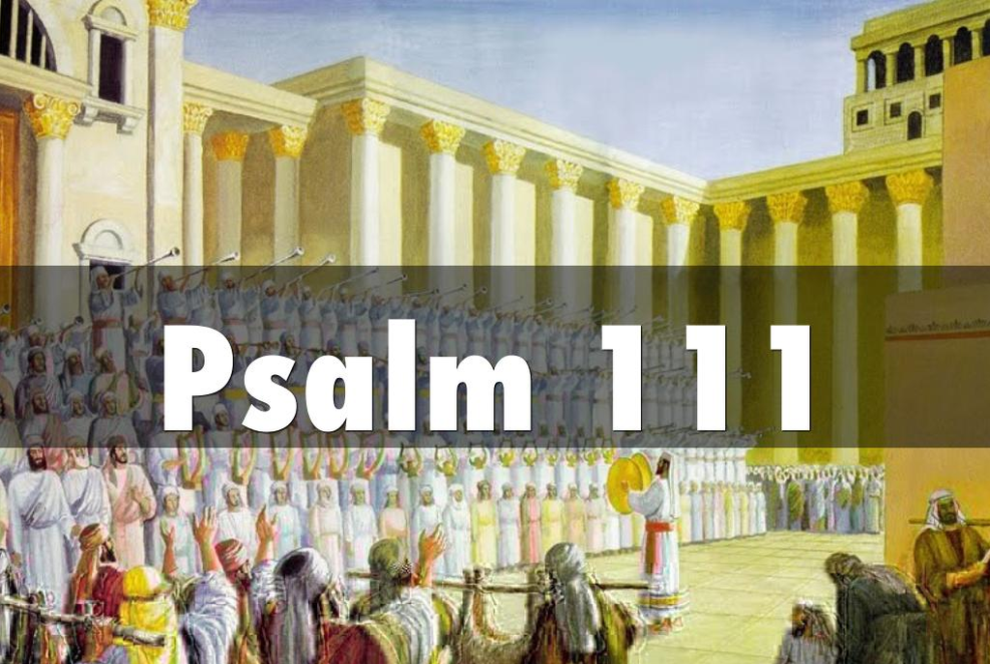

Slide 45
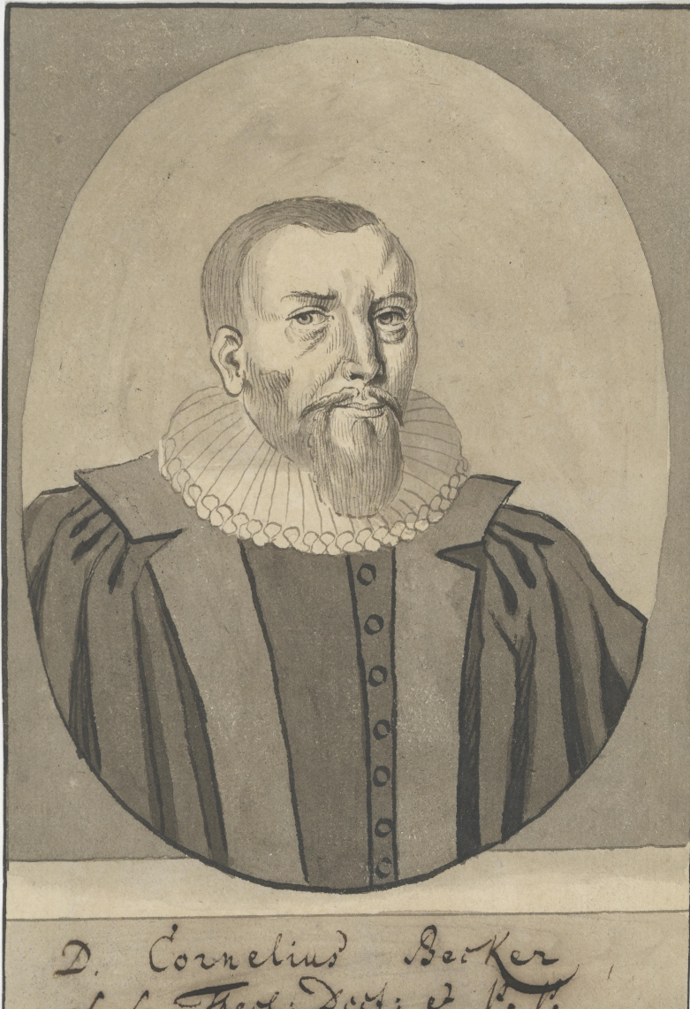
Notes:
Cornelius Becker (1561-1604)

Slide 46
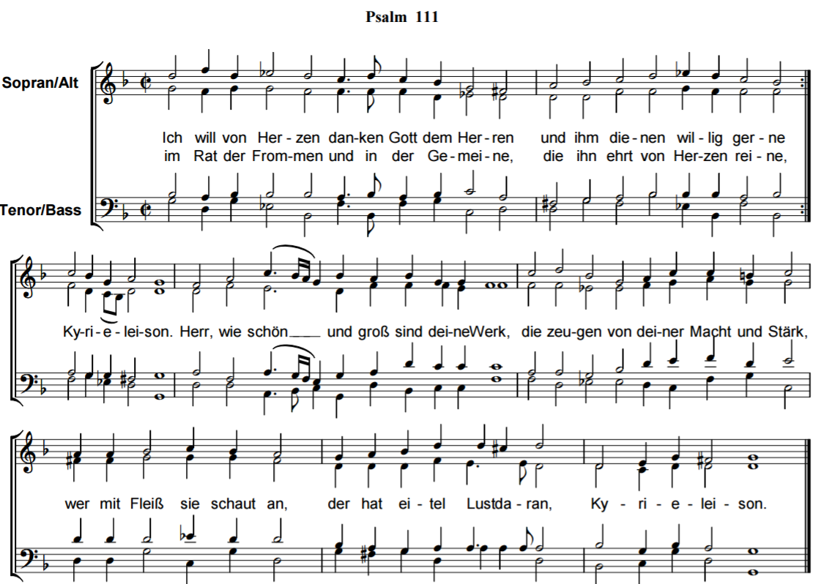

Slide 47
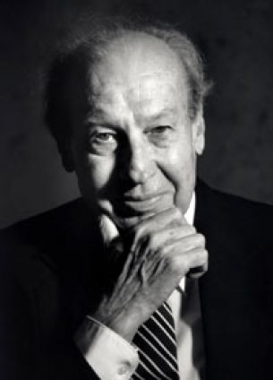
Notes:
Jaroslav Vajda (1919-2008)

Slide 48
Use of the Psalm in the Lectionary
Christmas 1 – Year B
15th Sunday after Trinity – Year B
23rd Sunday after Trinity – Year C

Slide 49
Notes about this selection
Why - new clothes for traditional texts?
original tune:
Ich will von Herzen danken Gott
Becker Psalter (1628, reprised 1986)

Slide 50
How the psalm can be sung in worship
All sing melody

Slide 54
Use of the Psalm in the Lectionary
Easter Day – Year A, B
Easter 5 – Year A
Easter Dawn – Year C

Slide 55
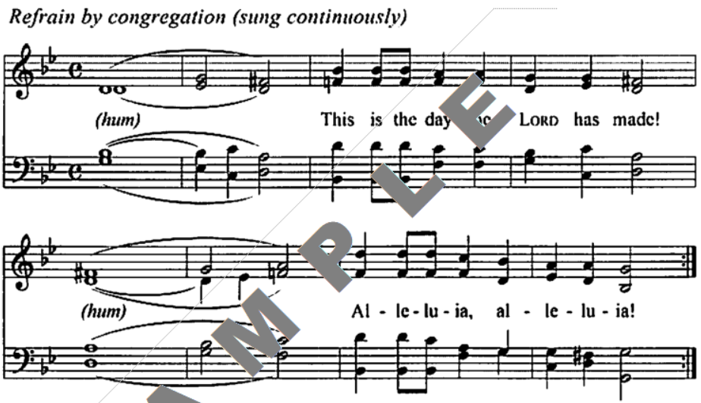
﻿No data for format specified.

Slide 56
Notes about this selection
Music from Taize - lends itself to psalmody
Repeated refrain - continuous music
Obbligato instrumental parts
Solo/choir singing over and above refrain
Reflective quality
Layout issues

Slide 57
How the psalm can be sung in worship
How do you start and finish?
Cantor or choir learns verses - cue for cong?
Electronic resources
instrumental parts; refrain descant

