Slide 1
Striving for Balance in Worship
WELS National Worship Conference 2017
Pastor Jon Micheel

Slide 2
or
?

Slide 3
It’s important to remember two things simultaneously.

Slide 4
Aims for this workshop
Develop a useful framework for thinking and talking about issues in worship:
Striving to keep two corresponding ideas in balance.
Discuss practical examples of what this looks like in a congregation’s worship life.

Slide 5
If this sounds familiar …
Martin Luther’s “On the Freedom of a Christian” (especially the last part about ceremonies)
Rev. Daniel Deutschlander’s The Narrow Lutheran Middle
Rev. Dan Leyrer’s “Of Snakes and Doves: Using Our Heads and Following Christ’s Heart in Evangelism”

Slide 6
Areas of discussion today
Agenda
Striving for balance in …
Continuity and Variety
Nurture and Outreach
Old and New
(Individual and Body)

Slide 7
The game plan
Agenda
I’ll present thoughts on one of the four areas
We’ll take a few minutes to process and talk
You can write notes on a blank page in your conference binder if you wish
I’ll make these slides available for download

Slide 8
Striving to Balance Continuity and Variety
In worship, we strive to leverage the advantages of doing things in a consistent way and also varying what we do.

Slide 9
An example of balancing continuity and variety:
Continuity & Variety

Slide 10
The value of continuity
Continuity & Variety
Ensures we get important things done
Embeds key spiritual truths in our minds
Especially valuable for …
pre-literate (e.g., young kids) & non-literate
those whose first language is not language used in worship

Slide 11
Cautions about continuity
Continuity & Variety
Patterns only as beneficial as their content
Can contribute to externalism
“I hate, I despise your religious festivals; your assemblies are a stench to me.” (Amos 5:21)
“And when you pray, do not keep on babbling like pagans, for they think they will be heard because of their many words.” (Matthew 6:7)

Slide 12
The value of variety
Continuity & Variety
Helps us proclaim the broad range of spiritual truths
By heightening mindfulness, mitigates danger of thoughtless repetition

Slide 13
Cautions about variety
Continuity & Variety
A little “stress” can be helpful; too much = distracting “distress”
“What’s happening next?” puts attention on process, not content
Too much variety can inhibit participation

Slide 14
Balancing continuity and variety Example 1: Ordinary and Propers
Continuity & Variety
Ordinary = recurring framework of texts, Word-Sacrament progression
Propers = Scripture readings, “of the Day” sections
Not just traditional; this system harnesses benefits of continuity and variety

Slide 15
Balancing continuity and variety Example 2: The Church Year
Continuity & Variety
Life of Jesus, then Life of the Church
Annual attention to key salvation events
Echoes of Old Testament annual cycle: reinforcing a range of vital truths

Slide 16
Balancing continuity and variety Example 3: Building repertoire of hymns
Continuity & Variety
“If I know a hymn, I sing it. If I don’t, I won’t.”
New music: fun to some, frustrating to others
Try a congregational repertoire of c. 250 hymns, then expand occasionally
Stretch, but not too far too fast
Introduce winsomely! “That sounds nice. Maybe I wouldn’t mind singing that…”

Slide 17
Balancing continuity and variety Example 4: Rotating orders seasonally
Continuity & Variety
Rotating 4-5 orders of service in one month: common practice?
Upside: no one order gets stale
Downside: takes a long time to learn an order, especially for guests, new members

Slide 18
Balancing continuity and variety Example 4: Rotating orders seasonally
Continuity & Variety
Suggestion: rotate 1-2 orders seasonally:
Epiphany (Jan-Feb): Service of Word and Sacrament, Haugen Morning Praise
Lenten Sundays (Mar-Apr): Common Service, Service of the Word (or gathering rite followed by one of those)
Easter Season: same two but with “This Is the Feast”
Pentecost Season (first part): Divine Service II, CW Morning Praise

Slide 19
Balancing continuity and variety Example 4: Rotating orders seasonally
Continuity & Variety
Adapt this to each congregation (e.g., one order per month)
Can be appreciated by
worshipers still getting acquainted with orders of service
musicians—especially those not as proficient

Slide 20
Balancing continuity and variety Example 5: Single rite, multiple settings
Continuity & Variety
Same basic progression of the service, same basic texts
Multiple musical settings
Combine this with previous suggestion: Don’t try different music every Sunday; rather, try one musical setting through a season

Slide 21
Balancing continuity and variety
Continuity & Variety
Tell someone next to you one thing from this section that you remember (1 minute)
Your thoughts, questions on this section?

Slide 22
Striving to Balance Nurture and Outreach
In worship, we strive to serve both those who don’t yet know the gospel and those who do.

Slide 23
Opinions shaped by (bad) experiences?
Nurture & Outreach
Have we witnessed …
a lack of concern for people who need the gospel?
“seeker-friendly” worship that compromises Scripture?
Can we acknowledge our experiences AND think beyond them?

Slide 24
Nurture and outreach are both essential!
Nurture & Outreach
But grow in the grace and knowledge of our Lord and Savior Jesus Christ. (2 Peter 3:18)
Jesus said, “Feed my sheep.” (John 21:17)
When he saw the crowds, he had compassion on them, because they were harassed and helpless, like sheep without a shepherd. (Matthew 9:36)
“Go and make disciples of all nations…” (Matthew 28:19)

Slide 25
Nurture and outreach are both essential!
Nurture & Outreach
Worship = a once-a-week respite & recharge for believers (Ps 120, 133-134) … and that’s good!
Worship = a can’t-pass-it-up chance to reach unbelievers
Reality: worship is often first contact with unchurched

Slide 26
Encouragements for veteran Christians
Nurture & Outreach
Generally we need stronger encouragement to do evangelism
“Freely you have received; freely give.” (Jesus in Mt 10:8)
Appreciation for liturgical worship takes time to develop
Etiquette for worship takes time to develop

Slide 27
Encouragements for veteran Christians
Nurture & Outreach
Beware the “curse of knowledge”!
not everyone knows the gospel you know so well
not everyone knows the customs so familiar to you
Educate, but don’t be condescending!
Worship education benefits everyone
A welcoming environment benefits everyone

Slide 28
Keep in mind …
Nurture & Outreach
Every place has protocol we need to learn
We can’t make everything instantly understandable
BUT our goal: remove hindrances to hearing gospel (If, before the service even begins…)

Slide 29
Keep in mind …
Nurture & Outreach
Look first for simple changes that will have beneficial impact. Examples:
Intentional welcome to worship
Clear notes, direction in the worship folder
Our motivation = “the love of Christ” (2 Co 5:14)
Concern for nurture and outreach = loving stewardship of God’s gifts

Slide 30
Balancing nurture and outreach
Nurture & Outreach
How have you experienced the tension between nurture and outreach in worship?
Any advice to help someone balance both in worship—proclaiming the gospel to the lost while building up the found?

Slide 31
Striving to Balance Old and New
In worship, we strive to use old, familiar treasures while also being open to what is new and unfamiliar.

Slide 32
Balancing requires constant evaluation, adjustments
Old & New

Slide 33
Balancing requires constant evaluation, adjustments
Old & New
As we discuss old and new elements in worship, we won’t find simple solutions.
But we can consider things that will help us evaluate and adjust.

Slide 34
Get beyond caricatures
Old & New
“All traditional music is …” Accurate?
“All contemporary music is …” Accurate?
See a snare drum and leave? See an organ and leave?
Willing to acknowledge both benefits and shortcomings?

Slide 35
Remember “Abusus non tollit usum.”
Old & New
Liturgy has been abused: empty ritualism, ex opere operato
Contemporary worship has been abused: emotionalism detached from gospel
But this does not rule out beneficial use
Be aware of potential abuses, take steps to prevent them

Slide 36
Examine substance, not just performance
Old & New
Reacting to drum kit too loud or organ too slow?
Take a second look at content, poetry, etc.
Be willing to work with resources, musicians
Strive for “best we can do with what we have”

Slide 37
Try stretching in both directions
Old & New
Try something old but unfamiliar
Try something new and of high quality
Introduce with patience and care!
choir or soloist to introduce, then support singing
teach it to the kids, then they can support singing
Seek high-quality resources both old and new
“Play within yourself”

Slide 38
We haven’t solved the “traditional vs. contemporary” debate, but …
Old & New
Based on your experience, comment on something in this section that could be helpful in balancing old and new elements in worship.

Slide 39
Striving to Balance the Individual and the Body
In worship, we strive to be attentive to the needs of the worshiping body and the worshiping individual.

Slide 40
The Body, Example 1: Confessing the Faith
Individual & Body
Speaking the Creed—insincere?
But another dimension: our shared identity as the body of Christ
Rightly defined catholicity—our connection with the Holy Christian Church
“We’re on board!”

Slide 41
The Body, Example 2: Singing
Individual & Body
Music in our age: almost all individual
Can music have purpose beyond entertainment? Example: the national anthem
Music in church: proclaiming and praising together
Setting aside individual preferences for a while for the benefit of the body
Group singing: doing one thing with bodies and minds

Slide 42
The Body, Example 2: Singing
Individual & Body
Suggestions:
Choose singable opening and closing hymns
Explain rationale for tougher hymns: “they’ve proven valuable for building faith”
Use soloist/choir to introduce harder hymns (make a good first impression)
Sing tough ones near the middle of the service

Slide 43
The Individual, Example 1: Encouraging personal devotional worship
Individual & Body
Freedom for personal confession, prayer, readings of my choice
Martin Luther: “I do not bind myself to such words or syllables, but say my prayers in one fashion today, in another tomorrow, depending on my mood and feeling …”

Slide 44
The Individual, Example 1: Encouraging personal devotional worship
Individual & Body
Apply this to music: listen to (or sing along with) songs and hymns that touch us personally
If only time I listen/sing is in church, then I’ll want all the songs to be my favorites!
Time for personal worship can increase satisfaction with corporate worship

Slide 45
The Individual, Example 2: Time for personal reflection in the service
Individual & Body
Examples of time for personal reflection/prayer:
Brief silence after confession, before absolution
Time for “private petitions”
Personal prayer during Communion distribution
After closing hymn, before announcements

Slide 46
The Individual, Example 2: Time for personal reflection in the service
Individual & Body
Examples of time for personal reflection/prayer:
After psalm in evening services
But simple instruction may be needed:
After the psalm, we will spend a few moments in silence. Some suggestions:
Reread the words of the psalm and think about what they’re saying.
Ask God to give you the blessings the psalm talks about.
Pray for someone who is on your mind.
Ask God for help with a stressful situation.

Slide 47
Balancing the individual and the body
Nurture & Outreach
Share a suggestion for helping address the needs of both individual worshipers and the body.
Your thoughts, questions on this topic?

Slide 49
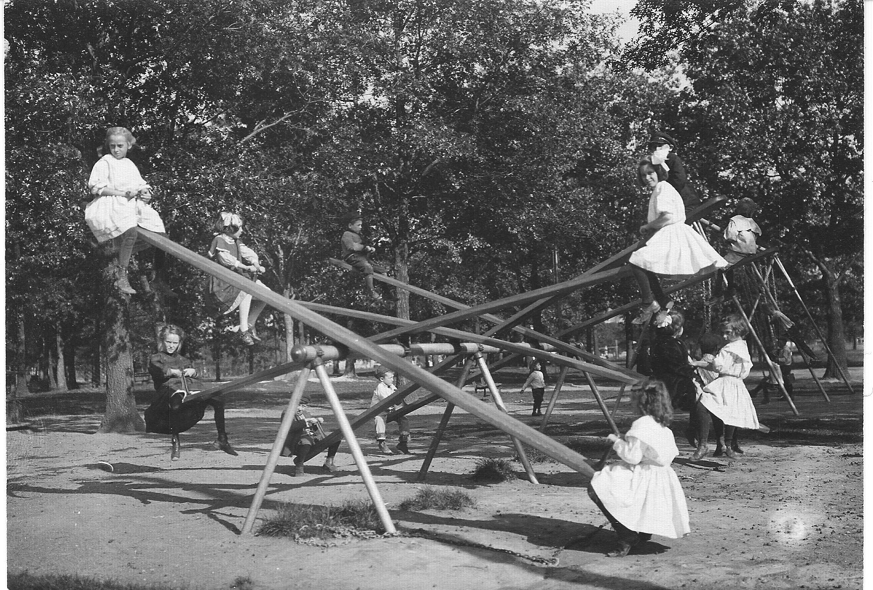

Slide 50
Evaluate and adjust as you strive for balance.
Strive to build people up and to glorify God!

Slide 51
Today’s slideshow will be available on the conference website soon. Pastor Jon Micheel pastorjm@popslc.org Office: 801-261-3808

