Slide 1
Worship & Outreach in a Midwestern Parish
July 19-22, 2011

Slide 2
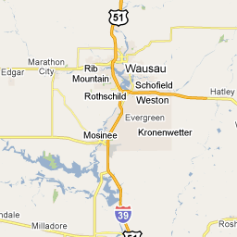
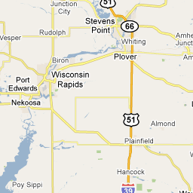
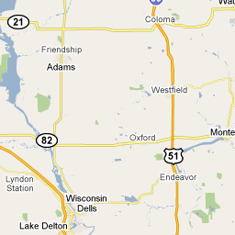
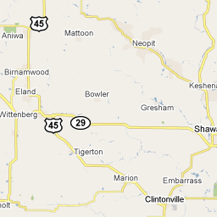
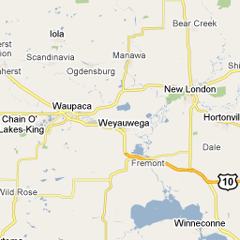
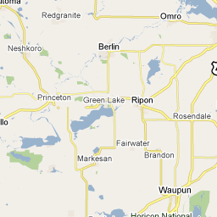
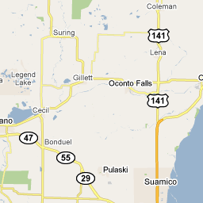
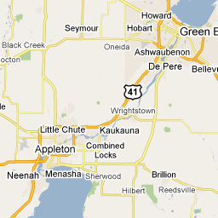
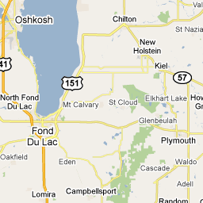
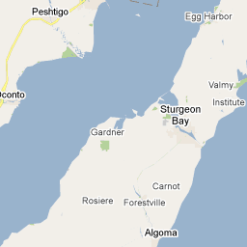
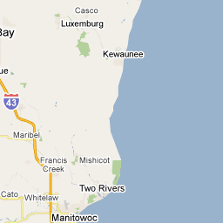
WELS Presence
Abiding Grace, Covington, GA
>50 Miles = 6 congregations
1575 members
about 1,500,000 Population
.001% WELS
Immanuel, Greenville
>10 Miles = 17 congregations
13,069 members
7 LES, 1 ALHS,
2 Childcares
>20 Miles = 36 congregations
23,512 members
15 LES, 1 ALHS, 2 Childcares
319,406 Population
7.4% WELS
Notes:
Don’t think we grasp how many WELS people. Give you a little synopsis of WELS Presence where we are – GUESS how many people belong to WELS churches within a 20 mile radius of our congregation. 23,512
Start off with 10 miles move to 20 miles.
How does this affect ministry?
PROS
Strength in numbers. People know who we are. High school working together.
Variety to meet your needs (McDonald’s with playland or not, still get your BIG MAC)
CONS
Family close by versus family far away – appreciate the bond more with people far away
Are people only looking for their needs to be met… easy to jump congregations. Appreciate the doctrine and so willing to work out issues?
Terrirtorialism – need to work on promoting no competition
Watch what you put in your grocery cart; don’t flip off another driver
False Idea that everybody knows Jesus (plenty of outreach opportunities)

Slide 3
Who Are We?
1860 – Primarily Farmers
Affluent Suburb of Appleton
Youthful Town
Growth of Town – 1990 (3700)
Growth of Congregation – 2005 (950) & Today (1500) – 2/3 new souls
Typical – Nice and Conservative
Notes:
1860 German Immigrants share a traveling pastor... Built this church in 1867.

Slide 4
Three Pillars of Ministry

Slide 5
Midwestern Stereotypes
See handout.
React to the statements from your experience – are they true or false and why. The best answers get a pen!
Confusion

Slide 6
Excellence in Worship and Outreach

Slide 7
“Excellence” in Worship & Outreach
Respond to the Pastor who says,
“When I hear we need ‘excellence’ in worship and outreach, I just feel guilty.”

Slide 8
Why Strive for Excellence?

Slide 9
Why strive for excellence?
Isaiah 6:1-8 In the year that King Uzziah died, I saw the Lord seated on a throne, high and exalted, and the train of his robe filled the temple. ² Above him were seraphs, each with six wings: With two wings they covered their faces, with two they covered their feet, and with two they were flying. ³ And they were calling to one another: "Holy, holy, holy is the LORD Almighty; the whole earth is full of his glory." ⁴ At the sound of their voices the doorposts and thresholds shook and the temple was filled with smoke.

Slide 10
Why strive for excellence?
⁵ "Woe to me!" I cried. "I am ruined! For I am a man of unclean lips, and I live among a people of unclean lips, and my eyes have seen the King, the LORD Almighty." ⁶ Then one of the seraphs flew to me with a live coal in his hand, which he had taken with tongs from the altar. ⁷ With it he touched my mouth and said, "See, this has touched your lips; your guilt is taken away and your sin atoned for." ⁸ Then I heard the voice of the Lord saying, "Whom shall I send? And who will go for us?" And I said, "Here am I. Send me!"

Slide 11
“Excellence” in Worship & Outreach
Greeters are “Doorkeepers for the King”

Slide 12
“Excellence” in Worship & Outreach
Greeters are “Doorkeepers for the King”
Worship for the King
Variety in service (Word, MP, DI, DII, W & S, Common – even TLH!)
Organists (Varying abilities) & Instrumentalists– Alternate Instrumentation
Fully printed worship folders & Powerpoints. www.onelicense.net and www.ccli.com

Slide 13
www.sermonview.com

Slide 19
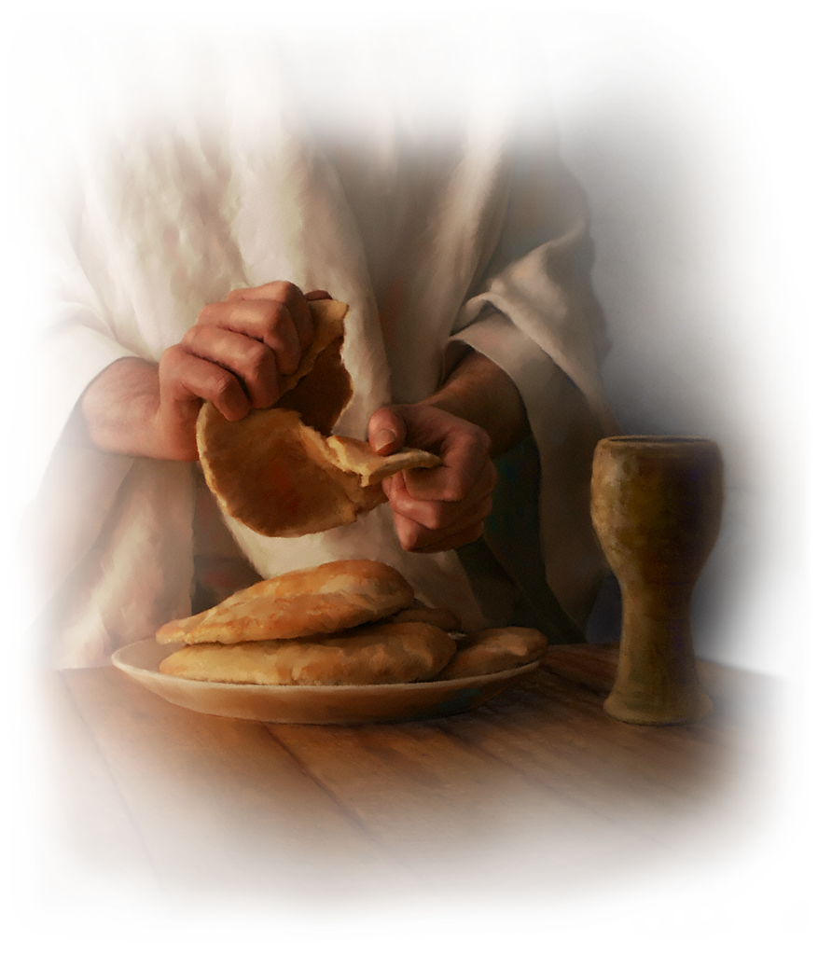

Slide 20
“Excellence” in Worship & Outreach
Greeters are “Doorkeepers for the King”
Worship for the King
Train Your People – This is your worship!
How?
Mission of the Church (every year!)
Evangelism Sunday
Use Pentecost and Epiphany themes
Pastors – do home visits

Slide 21
“Excellence” in Worship & Outreach
Greeters are “Doorkeepers for the King”
Worship for the King
Train your people – this is your worship
Use God’s people! “As those who have just come from the courtroom of the great King” like Isaiah

Slide 22
Midwest Keys to Excellence

Slide 23
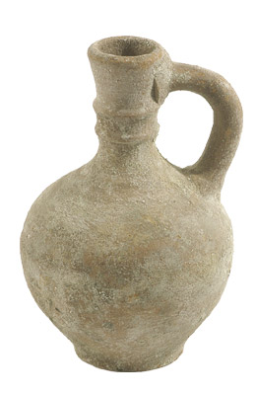
Midwest Keys to Excellence
“But we have this treasure in jars of clay to show that this all-surpassing power is from God and not from us.” - 2 Corinthians 4:7

Slide 24
Midwest Keys to Excellence
See Handout.
Give the best response to common Midwestern WELS criticism.
The best answers get a pen!

Slide 25
Midwest Keys to Excellence
Highlight the Treasure!
BIC schedule and advertising
Special invitations – hand deliver
Different formats – different classes – different times
Immanuel has 4 official classes per year (always have one going)

Slide 26
Midwest Keys to Excellence
See Handout.
Look at the survey results and put the percentages in the right place. Winner may get an Immanuel mug.

Slide 27
Midwest Keys to Excellence
Highlight the Treasure!
Use Relationships!
Farming idea
Constant invitation opportunities
Encourage by showing excitement over their efforts.

Slide 28
Using a Great Resource
John 1:35-51 The next day John was there again with two of his disciples. ³⁶ When he saw Jesus passing by, he said, "Look, the Lamb of God!" ³⁷ When the two disciples heard him say this, they followed Jesus. ³⁸ Turning around, Jesus saw them following and asked, "What do you want?" They said, "Rabbi" (which means Teacher), "where are you staying?" ³⁹ "Come," he replied, "and you will see." So they went and saw where he was staying, and spent that day with him. It was about the tenth hour.

Slide 29
Using a Great Resource
⁴⁰ Andrew, Simon Peter's brother, was one of the two who heard what John had said and who had followed Jesus. ⁴¹ The first thing Andrew did was to find his brother Simon and tell him, "We have found the Messiah" (that is, the Christ). ⁴² And he brought him to Jesus. Jesus looked at him and said, "You are Simon son of John. You will be called Cephas" (which, when translated, is Peter). ⁴³ The next day Jesus decided to leave for Galilee. Finding Philip, he said to him, "Follow me."

Slide 30
Using a Great Resource
⁴⁴ Philip, like Andrew and Peter, was from the town of Bethsaida. ⁴⁵ Philip found Nathanael and told him, "We have found the one Moses wrote about in the Law, and about whom the prophets also wrote-- Jesus of Nazareth, the son of Joseph." ⁴⁶ "Nazareth! Can anything good come from there?" Nathanael asked. "Come and see," said Philip. ⁴⁷ When Jesus saw Nathanael approaching, he said of him, "Here is a true Israelite, in whom there is nothing false."

Slide 31
Using a Great Resource
⁴⁸ "How do you know me?" Nathanael asked. Jesus answered, "I saw you while you were still under the fig tree before Philip called you." ⁴⁹ Then Nathanael declared, "Rabbi, you are the Son of God; you are the King of Israel." ⁵⁰ Jesus said, "You believe because I told you I saw you under the fig tree. You shall see greater things than that." ⁵¹ He then added, "I tell you the truth, you shall see heaven open, and the angels of God ascending and descending on the Son of Man."

Slide 32
Midwest Keys to Excellence
Highlight the Treasure
Use Relationships
Use the Children
VBS/Christmas for kids/Easter for kids
Power hour/Playgroup in the park
Sunday school
3 & 4 year pre-K/after school care
LES
Children’s Sermons

Slide 33
Planning in Worship & Outreach

Slide 34
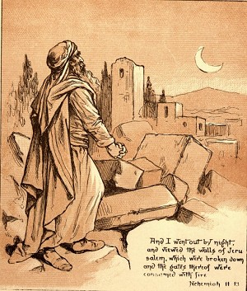
Planning and “Ora et Labora”
Example of Nehemiah

Slide 35
Planning in Worship and Outreach
What should I do?

Slide 36
Planning in Worship and Outreach
At least 6 months – Worship & Outreach!
January Events:
Winter BIC begins
New Member Welcome (1st Sunday of January between services)
Committee tasks:
Promote Power Hour
Contact Koine for VBS week
Begin to organize VBS (curriculum; coordinators, etc.)
Finalize ad for Greenville newsletter (Easter for Kids; Easter services) – deadline is 2/1/11
Welcome New Movers

Slide 37
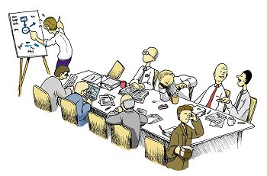
Planning in Worship and Outreach
Action Meetings
Areas of Concentration (Pastor is not “in charge” of everything)
200 members involved with outreach (i.e. greeters, canvassers, new mover visits, cookie follow up, etc.)
Make Evangelism Meetings Count

Slide 38
Planning in Worship and Outreach
Budget ($14,000)
1. New Mover’s Lists: $500
2. Welcome pack materials: $750
3. Postage (prospect newsletters): $300
4. Graphic Design: $500
5. Mass mailings (5): $3,000
6. Visitor Gifts (BIC Bibles, etc.): $500
7. Comm. Outreach/Greenville Parade: $500
8. Advertising: $800
9. Friendship Registers: $150
10. Community event (“Celebration of Grace”): $2500
11. Christmas for Kids/Easter for Kids: $1000
12. VBS: $3000
11. Playgroup/Power Hour: $500

Slide 39
Planning in Worship and Outreach
Constant “Come and See” events:
Community Picnic/Kids Carnival
Trunk or Treat
Christmas/Easter for Kids
Christmas/Easter services
“Powerhour” in fall and spring
Playgroup in the park
Constant BIC courses
Summer Sermon Series

Slide 40
Planning in Worship and Outreach
Advertising
Mass Mailings
Prospect List (Excel document and dropbox.com) and Outreach Newsletters from NPH ($27/year)
Greenville Newsletter ($500/year)
Banner at ballpark ($300)
Professional Graphic designer
Postcards – www.overnightprints.com

Slide 43
Planning in Worship and Outreach
Constant “Go” events:
Greenville Parade
Cookies to visitors (36 hours!)
Personal card writers for un-churched.
New mover welcome (www.outreach.com or www.newmoverchurchpostcards.com)
Summer weekly canvass (June-Aug)
Flyer distribution
Prospect calls by Pastor and laity - Keep going.
You want everyone to say, “I know your church!”

Slide 44
Summary
Strive for “Excellence” for your King in your setting.
Treasure the powerful Gospel, use your people, your children and your relationships.
Plan! Plan! Plan!

Slide 45
Closing Encouragement
Like newborn babies, crave pure spiritual milk, so that by it you may grow up in your salvation, now that you have tasted that the Lord is good.
- 1 Peter 2:2-3

